Slide 1
Econ 642 Week 5
Investment and Equilibrium
Kurlat Chapter 8 and 9

Slide 2
Announcement
Midterm next week (1/14/2025)
Chapter 9 will be moved to after the Midterm
Midterm includes everything from Economic Growth Accounting to Investment Decisions
Review material will be available on ELMS
Discussion 5 Available
We’ll cover Search Costs and Friction in the Labor Market
Problem Set 2 Due (1/9/2025)
Presentation Set 2 is on Friday, January 17
Please send a copy by January 10-11

Slide 3
Overview
Investment Decisions
General Equilibrium

Slide 4
Investment
Kurlat Chapter 8

Slide 5
Overview
Investment Decisions
Present Value
Asset Prices, Adjustment Costs, and The Theory of Investment
Risk
The Marginal Product of Capital, Investment Demand Schedule, and Aggregate Investment

Slide 6
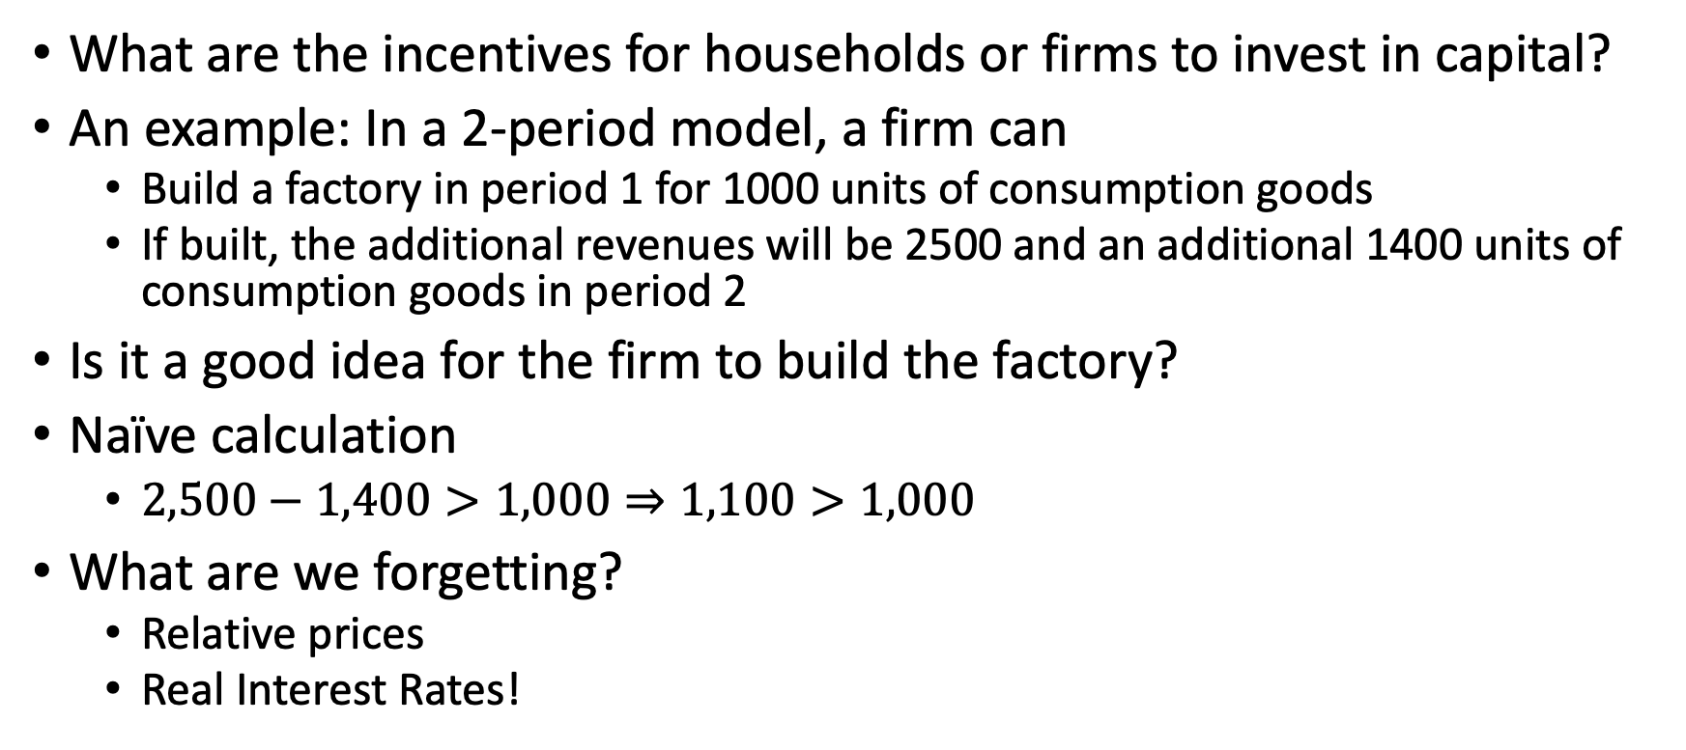
Investment Decisions
What are the incentives for households or firms to invest in capital?
An example: In a 2-period model, a firm can
Build a factory in period 1 for 1000 units of consumption goods
If built, the additional revenues will be 2500 and an additional 1400 units of consumption goods in period 2
Is it a good idea for the firm to build the factory?
Naïve calculation
$2,500−1,400>1,000⇒1,100>1,000$
What are we forgetting?
Relative prices
Real Interest Rates!

Slide 7
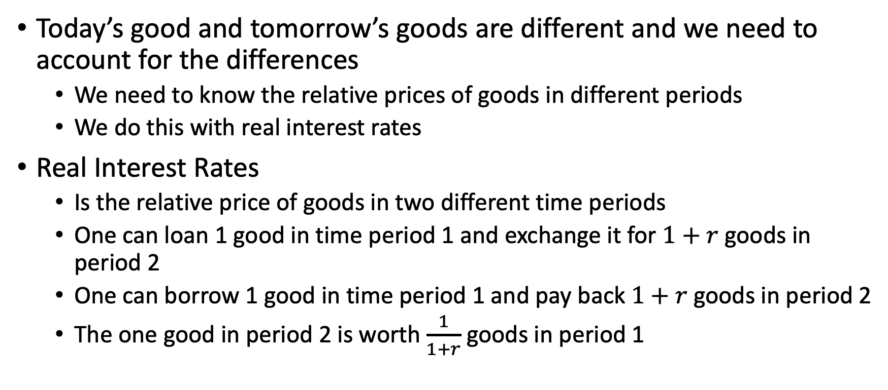
Investment Decisions
Today’s good and tomorrow’s goods are different and we need to account for the differences
We need to know the relative prices of goods in different periods
We do this with real interest rates
Real Interest Rates
Is the relative price of goods in two different time periods
One can loan 1 good in time period 1 and exchange it for $1+r$ goods in period 2
One can borrow 1 good in time period 1 and pay back $1+r$ goods in period 2
The one good in period 2 is worth $\frac{1}{1+r}$ goods in period 1

Slide 8
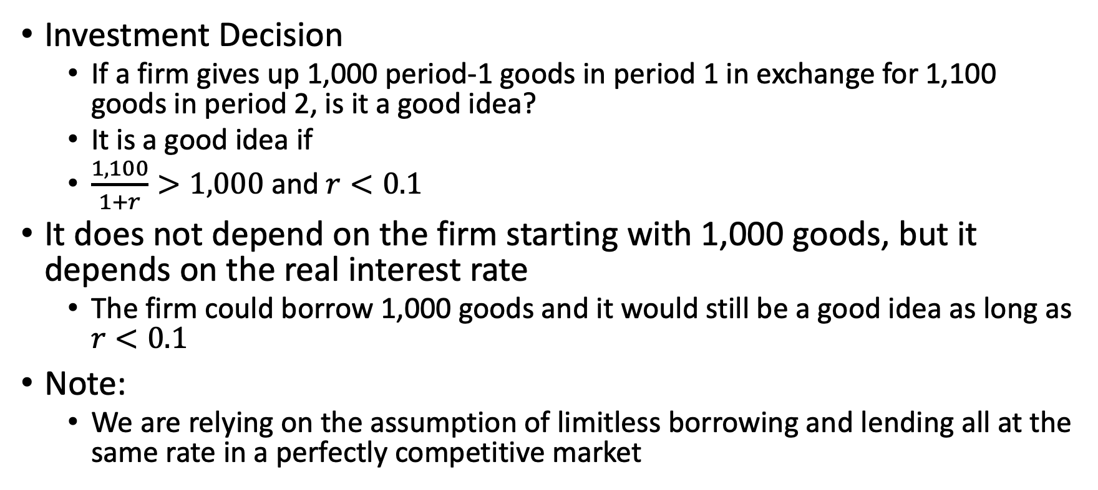
Investment Decisions
Investment Decision
If a firm gives up 1,000 period-1 goods in period 1 in exchange for 1,100 goods in period 2, is it a good idea?
It is a good idea if
$\frac{1,100}{1+r}>1,000$ and $r<0.1$
It does not depend on the firm starting with 1,000 goods, but it depends on the real interest rate
The firm could borrow 1,000 goods and it would still be a good idea as long as $r<0.1$
Note:
We are relying on the assumption of limitless borrowing and lending all at the same rate in a perfectly competitive market

Slide 9
Present Values

Slide 10
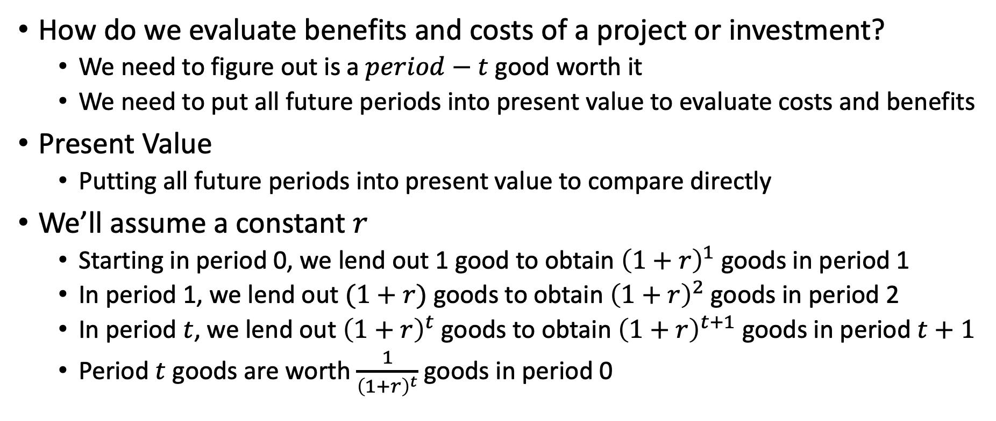
Present Values
How do we evaluate benefits and costs of a project or investment?
We need to figure out is a $period−t$ good worth it
We need to put all future periods into present value to evaluate costs and benefits
Present Value
Putting all future periods into present value to compare directly
We’ll assume a constant $r$
Starting in period 0, we lend out 1 good to obtain ${\left(1+r\right)}^{1}$ goods in period 1
In period 1, we lend out $(1+r)$ goods to obtain ${\left(1+r\right)}^{2}$ goods in period 2
In period $t$, we lend out ${\left(1+r\right)}^{t}$ goods to obtain ${\left(1+r\right)}^{t+1}$ goods in period $t+1$
Period $t$ goods are worth $\frac{1}{{\left(1+r\right)}^{t}}$ goods in period 0

Slide 11
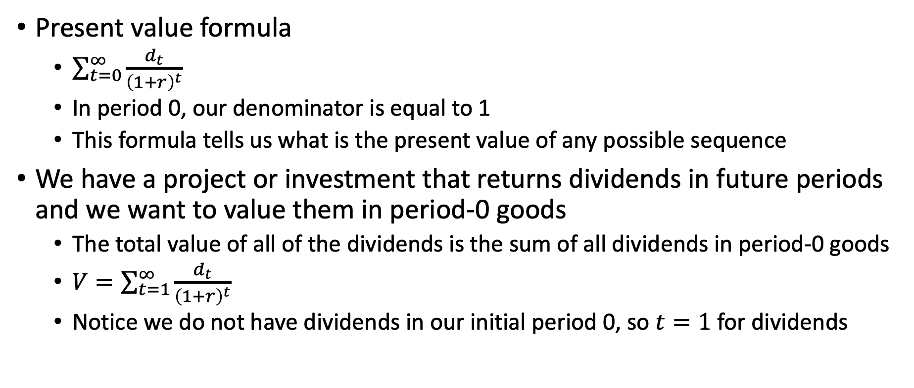
Present Values
Present value formula
$\sum_{t=0}^{∞}{\frac{d_{t}}{{\left(1+r\right)}^{t}}}$
In period 0, our denominator is equal to 1
This formula tells us what is the present value of any possible sequence
We have a project or investment that returns dividends in future periods and we want to value them in period-0 goods
The total value of all of the dividends is the sum of all dividends in period-0 goods
$V=\sum_{t=1}^{∞}{\frac{d_{t}}{{\left(1+r\right)}^{t}}}$
Notice we do not have dividends in our initial period 0, so $t=1$ for dividends

Slide 12
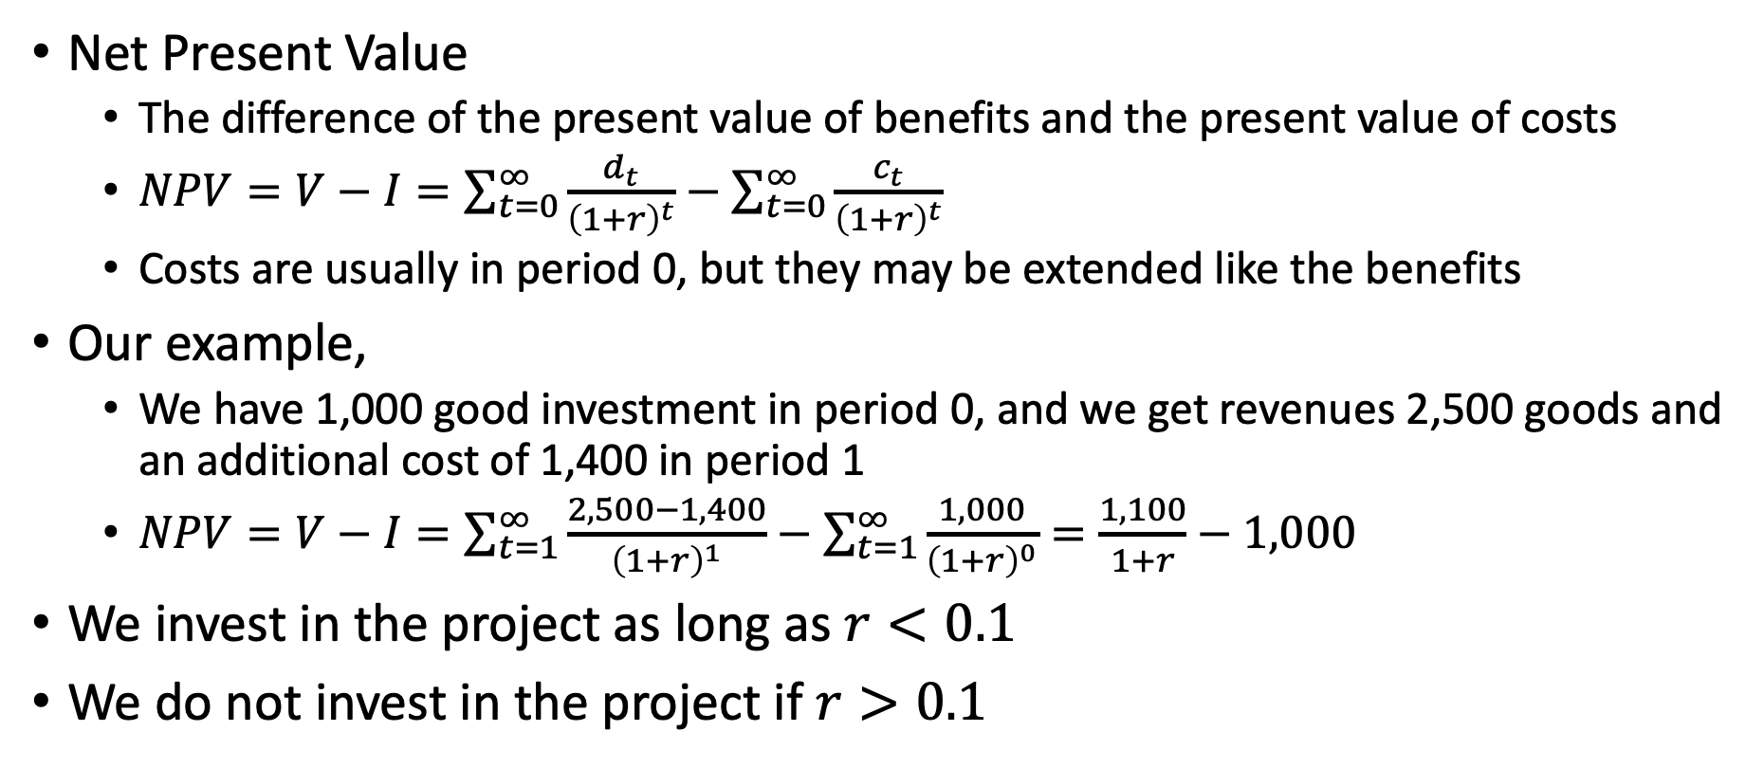
Present Values
Net Present Value
The difference of the present value of benefits and the present value of costs
$NPV=V−I=\sum_{t=0}^{∞}{\frac{d_{t}}{{\left(1+r\right)}^{t}}}−\sum_{t=0}^{∞}{\frac{c_{t}}{{\left(1+r\right)}^{t}}}$
Costs are usually in period 0, but they may be extended like the benefits
Our example,
We have 1,000 good investment in period 0, and we get revenues 2,500 goods and an additional cost of 1,400 in period 1
$NPV=V−I=\sum_{t=1}^{∞}{\frac{2,500−1,400}{{\left(1+r\right)}^{1}}}−\sum_{t=1}^{∞}{\frac{1,000}{{\left(1+r\right)}^{0}}}=\frac{1,100}{1+r}−1,000$
We invest in the project as long as $r<0.1$
We do not invest in the project if $r>0.1$

Slide 13
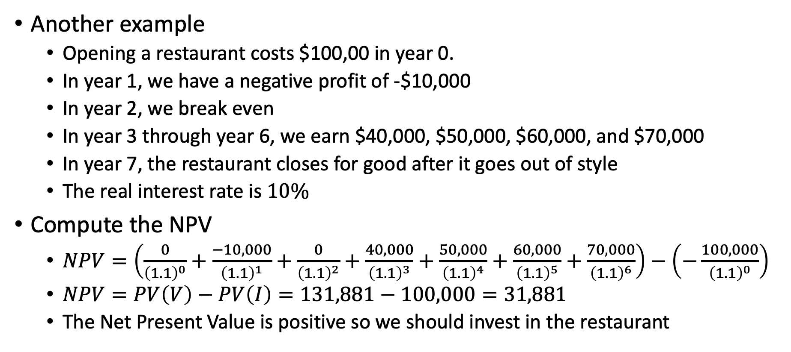
Present Values
Another example
Opening a restaurant costs $100,00 in year 0.
In year 1, we have a negative profit of -$10,000
In year 2, we break even
In year 3 through year 6, we earn $40,000, $50,000, $60,000, and $70,000
In year 7, the restaurant closes for good after it goes out of style
The real interest rate is $10\%$
Compute the NPV
$NPV=\left(\frac{0}{{\left(1.1\right)}^{0}}+\frac{−10,000}{{\left(1.1\right)}^{1}}+\frac{0}{{\left(1.1\right)}^{2}}+\frac{40,000}{{\left(1.1\right)}^{3}}+\frac{50,000}{{\left(1.1\right)}^{4}}+\frac{60,000}{{\left(1.1\right)}^{5}}+\frac{70,000}{{\left(1.1\right)}^{6}}\right)−\left(−\frac{100,000}{{\left(1.1\right)}^{0}}\right)$
$NPV=PV\left(V\right)−PV\left(I\right)=131,881−100,000=31,881$
The Net Present Value is positive so we should invest in the restaurant

Slide 14
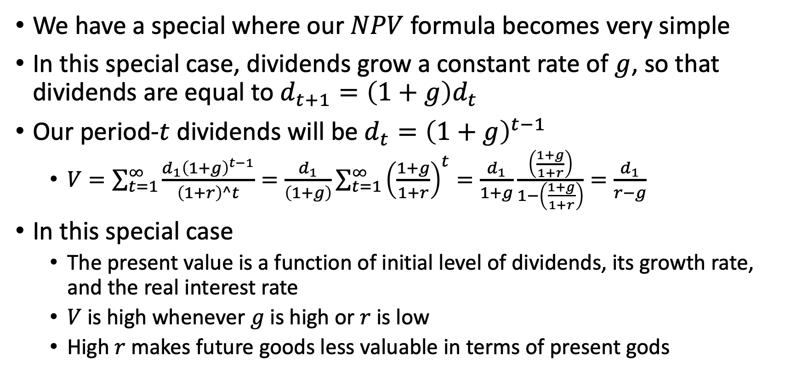
The Gordon Growth Formula
We have a special where our $NPV$ formula becomes very simple
In this special case, dividends grow a constant rate of $g$, so that dividends are equal to $d_{t+1}=\left(1+g\right)d_{t}$
Our period-$t$ dividends will be $d_{t}={\left(1+g\right)}^{t−1}$
$V=\sum_{t=1}^{∞}{\frac{d_{1}{\left(1+g\right)}^{t−1}}{\left(1+r\right)^t}=\frac{d_{1}}{\left(1+g\right)}\sum_{t=1}^{∞}{{\left(\frac{1+g}{1+r}\right)}^{t}=\frac{d_{1}}{1+g}}\frac{\left(\frac{1+g}{1+r}\right)}{1−\left(\frac{1+g}{1+r}\right)}=\frac{d_{1}}{r−g}}$
In this special case
The present value is a function of initial level of dividends, its growth rate, and the real interest rate
$V$ is high whenever $g$ is high or $r$ is low
High $r$ makes future goods less valuable in terms of present gods

Slide 15
Asset Prices, Adjustment Costs, and Tobin’s Q
What if a project is already in place, how much should we be willing to pay for it?
We have been thinking about potential projects
We can also think about present value of existing investments and projects
There are markets where people actively trade assets that are already producing dividends
People trade share of companies on stock market
People trade commercial and residential real estate producing real estate services, such as housing services and commercial rental space
People trade bonds already paying coupons in the bond market
NPV formula tells us what should be the price at which people trade

Slide 16
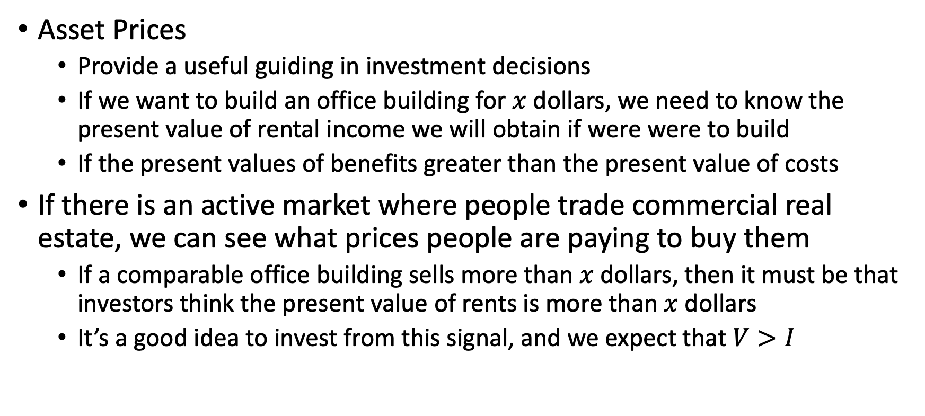
Asset Prices, Adjustment Costs, and Tobin’s Q
Asset Prices
Provide a useful guiding in investment decisions
If we want to build an office building for $x$ dollars, we need to know the present value of rental income we will obtain if were were to build
If the present values of benefits greater than the present value of costs
If there is an active market where people trade commercial real estate, we can see what prices people are paying to buy them
If a comparable office building sells more than $x$ dollars, then it must be that investors think the present value of rents is more than $x$ dollars
It’s a good idea to invest from this signal, and we expect that $V>I$

Slide 17
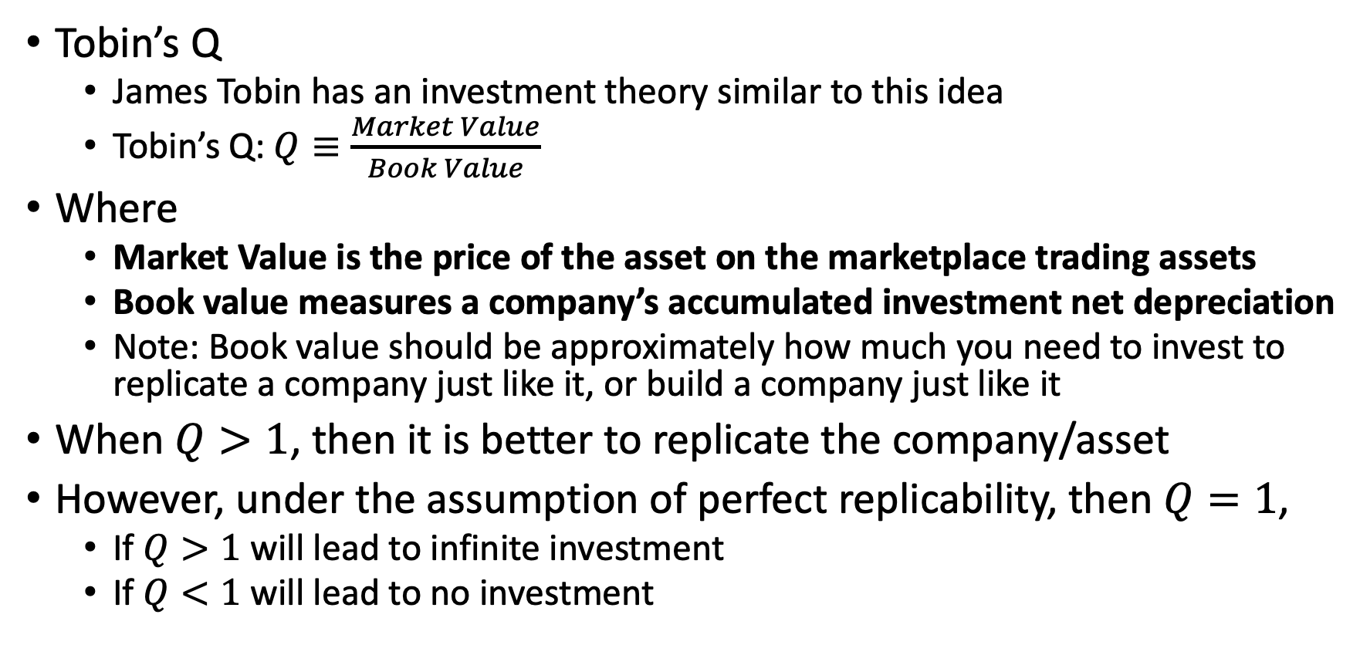
Asset Prices, Adjustment Costs, and Tobin’s Q
Tobin’s Q
James Tobin has an investment theory similar to this idea
Tobin’s Q: $Q≡\frac{Market Value}{Book Value}$
Where
Market Value is the price of the asset on the marketplace trading assets
Book value measures a company’s accumulated investment net depreciation
Note: Book value should be approximately how much you need to invest to replicate a company just like it, or build a company just like it
When $Q>1$, then it is better to replicate the company/asset
However, under the assumption of perfect replicability, then $Q=1$,
If $Q>1$ will lead to infinite investment
If $Q<1$ will lead to no investment

Slide 18
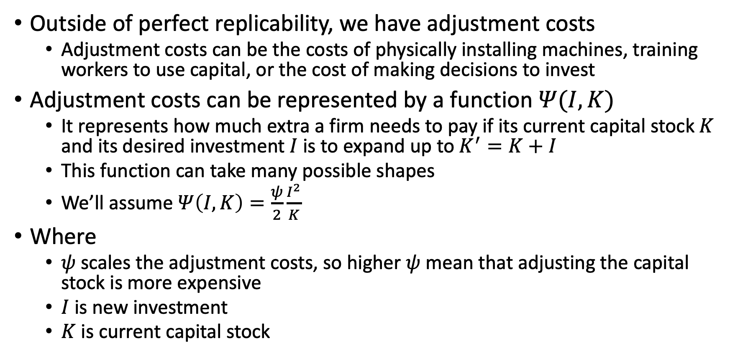
Asset Prices, Adjustment Costs, and Tobin’s Q
Outside of perfect replicability, we have adjustment costs
Adjustment costs can be the costs of physically installing machines, training workers to use capital, or the cost of making decisions to invest
Adjustment costs can be represented by a function $Ψ(I,K)$
It represents how much extra a firm needs to pay if its current capital stock $K$ and its desired investment $I$ is to expand up to $K^{′}=K+I$
This function can take many possible shapes
We’ll assume $Ψ\left(I,K\right)=\frac{ψ}{2}\frac{I^{2}}{K}$
Where
$ψ$ scales the adjustment costs, so higher $ψ$ mean that adjusting the capital stock is more expensive
$I$ is new investment
$K$ is current capital stock

Slide 19
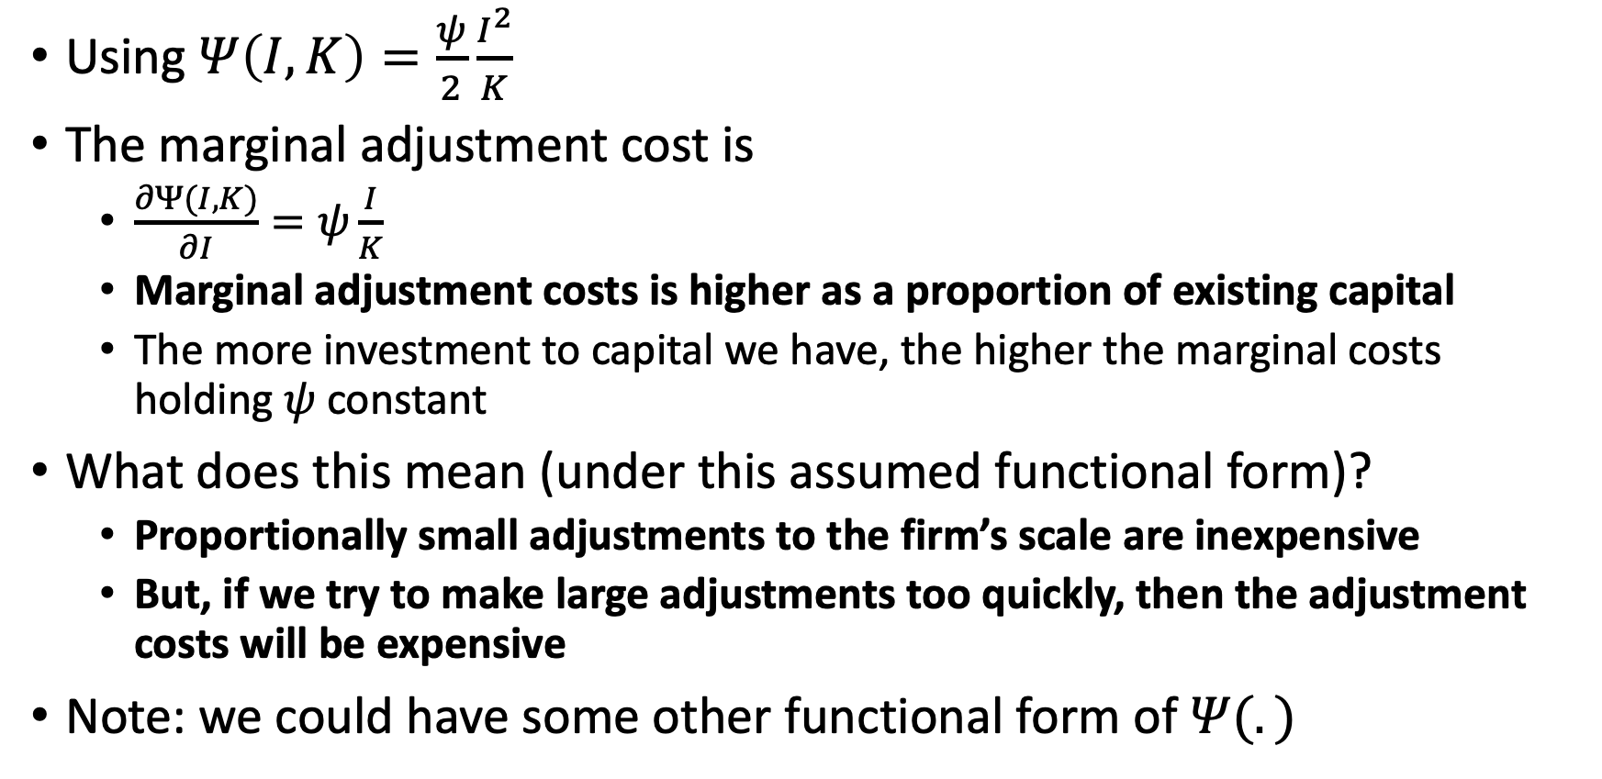
Asset Prices, Adjustment Costs, and Tobin’s Q
Using $Ψ\left(I,K\right)=\frac{ψ}{2}\frac{I^{2}}{K}$
The marginal adjustment cost is
$\frac{∂Ψ(I,K)}{∂I}=ψ\frac{I}{K}$
Marginal adjustment costs is higher as a proportion of existing capital
The more investment to capital we have, the higher the marginal costs holding $ψ$ constant
What does this mean (under this assumed functional form)?
Proportionally small adjustments to the firm’s scale are inexpensive
But, if we try to make large adjustments too quickly, then the adjustment costs will be expensive
Note: we could have some other functional form of $Ψ(.)$

Slide 20
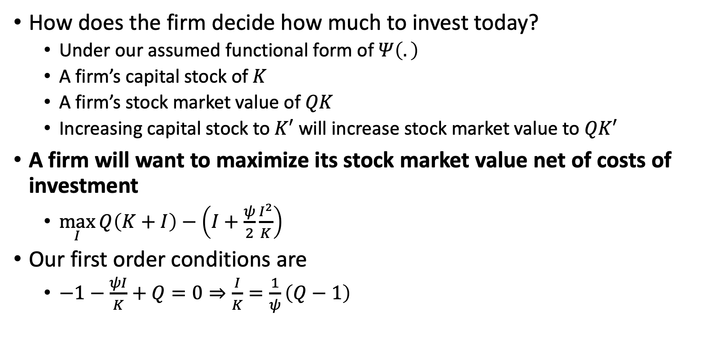
Asset Prices, Adjustment Costs, and Tobin’s Q
How does the firm decide how much to invest today?
Under our assumed functional form of $Ψ\left(.\right)$
A firm’s capital stock of $K$
A firm’s stock market value of $QK$
Increasing capital stock to $K′$ will increase stock market value to $QK′$
A firm will want to maximize its stock market value net of costs of investment
$\max_{I}{Q\left(K+I\right)−\left(I+\frac{ψ}{2}\frac{I^{2}}{K}\right)}$
Our first order conditions are
$−1−\frac{ψI}{K}+Q=0⇒\frac{I}{K}=\frac{1}{ψ}\left(Q−1\right)$

Slide 21
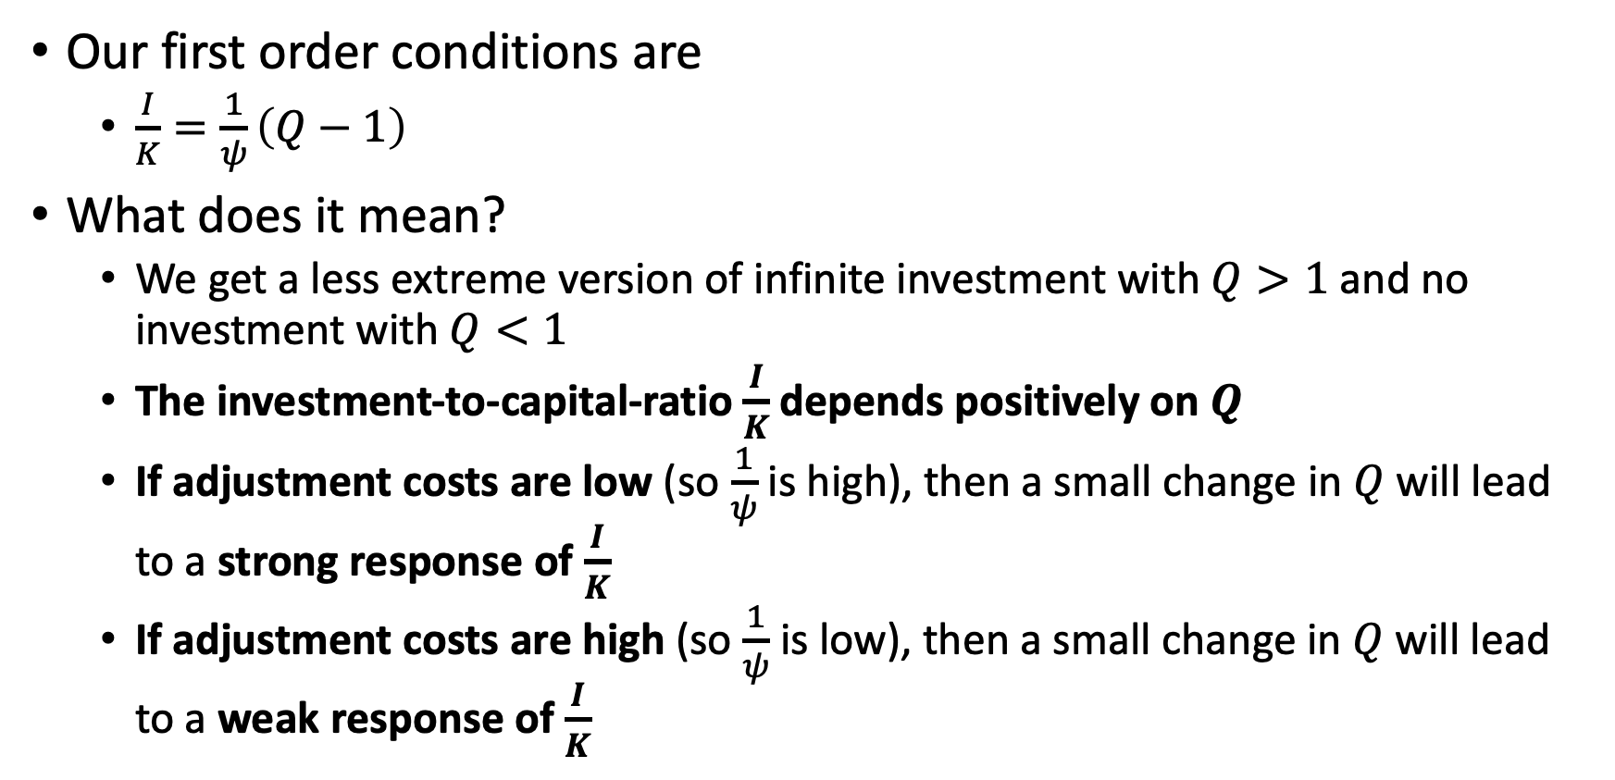
Asset Prices, Adjustment Costs, and Tobin’s Q
Our first order conditions are
$\frac{I}{K}=\frac{1}{ψ}\left(Q−1\right)$
What does it mean?
We get a less extreme version of infinite investment with $Q>1$ and no investment with $Q<1$
The investment-to-capital-ratio $\frac{I}{K}$ depends positively on $Q$
If adjustment costs are low (so $\frac{1}{ψ}$ is high), then a small change in $Q$ will lead to a strong response of $\frac{I}{K}$
If adjustment costs are high (so $\frac{1}{ψ}$ is low), then a small change in $Q$ will lead to a weak response of $\frac{I}{K}$

Slide 22
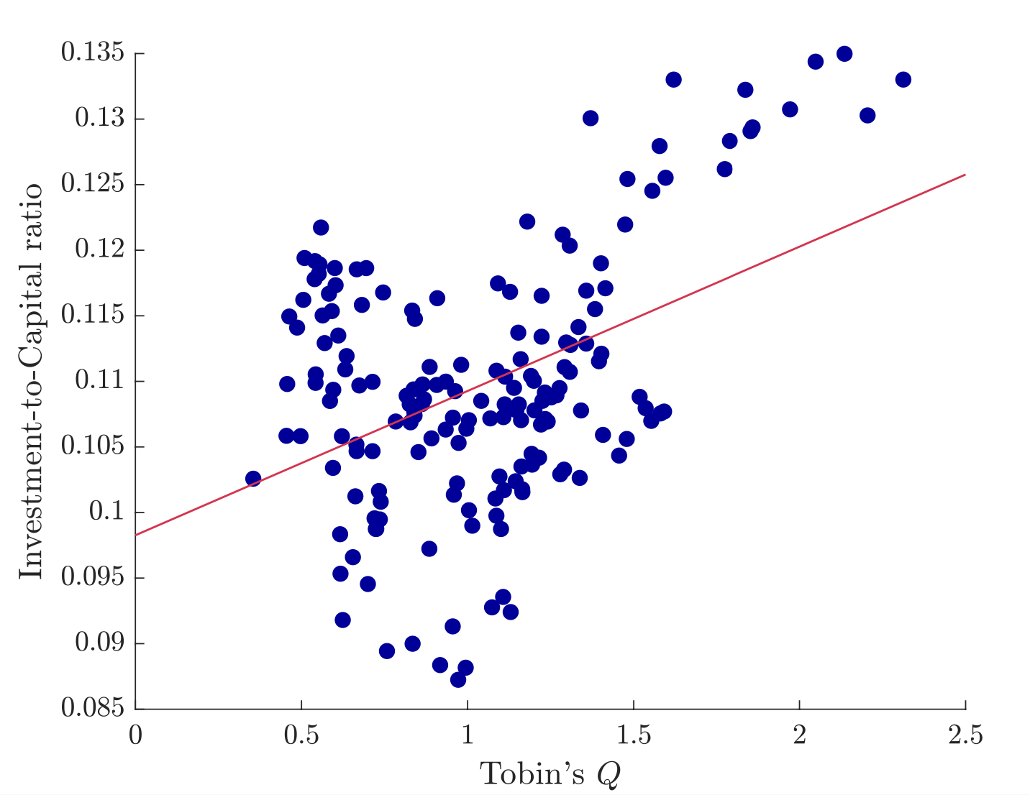
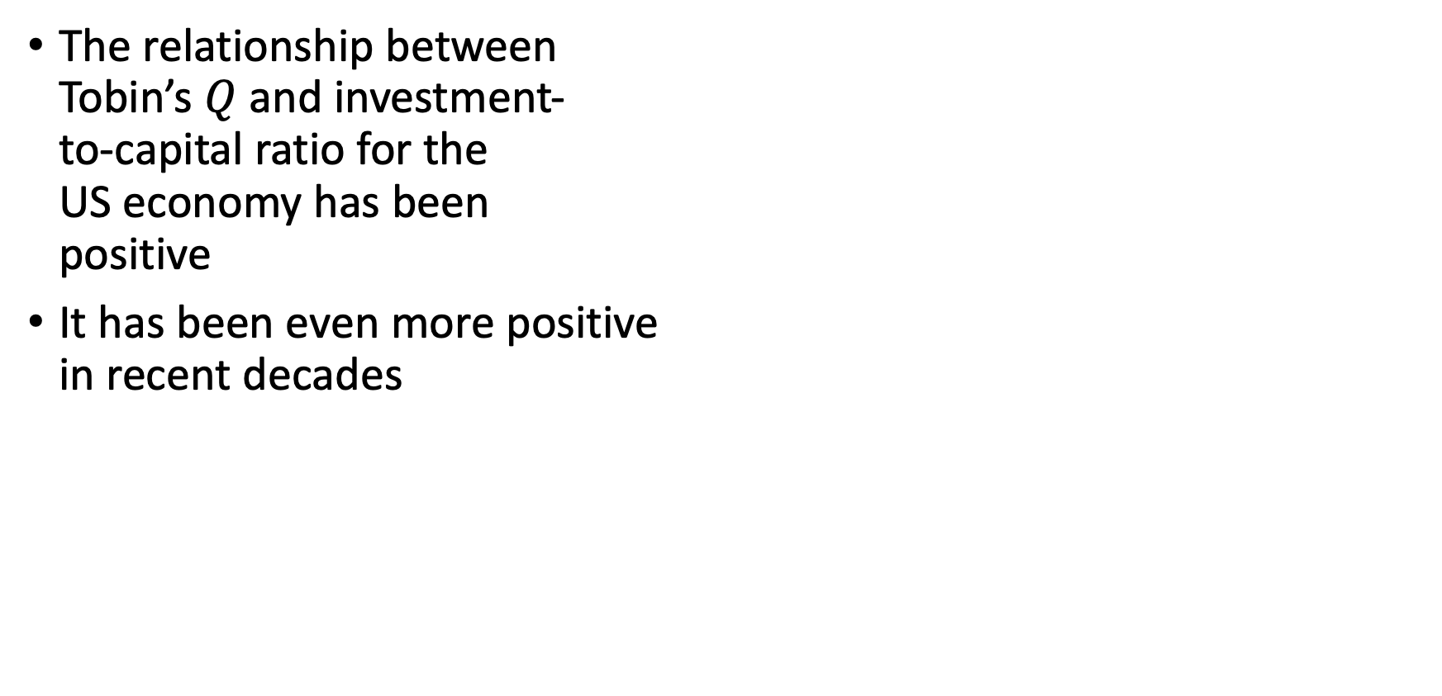
Asset Prices, Adjustment Costs, and Tobin’s Q
The relationship between Tobin’s $Q$ and investment- to-capital ratio for the US economy has been positive
It has been even more positive in recent decades

Slide 23
Risk

Slide 24
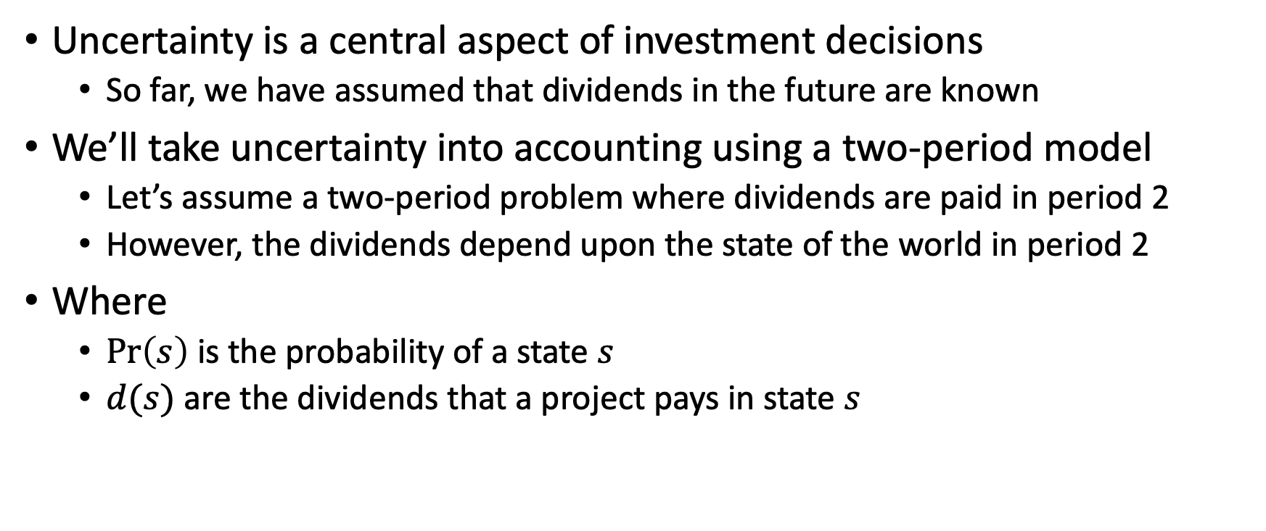
Risk
Uncertainty is a central aspect of investment decisions
So far, we have assumed that dividends in the future are known
We’ll take uncertainty into accounting using a two-period model
Let’s assume a two-period problem where dividends are paid in period 2
However, the dividends depend upon the state of the world in period 2
Where
$\operatorname{Pr}\left(s\right)$ is the probability of a state $s$
$d(s)$ are the dividends that a project pays in state $s$

Slide 25
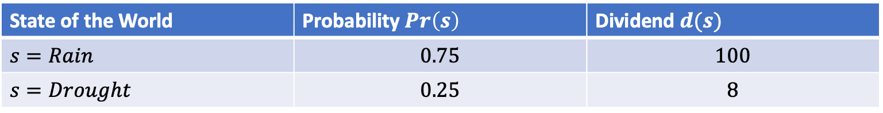
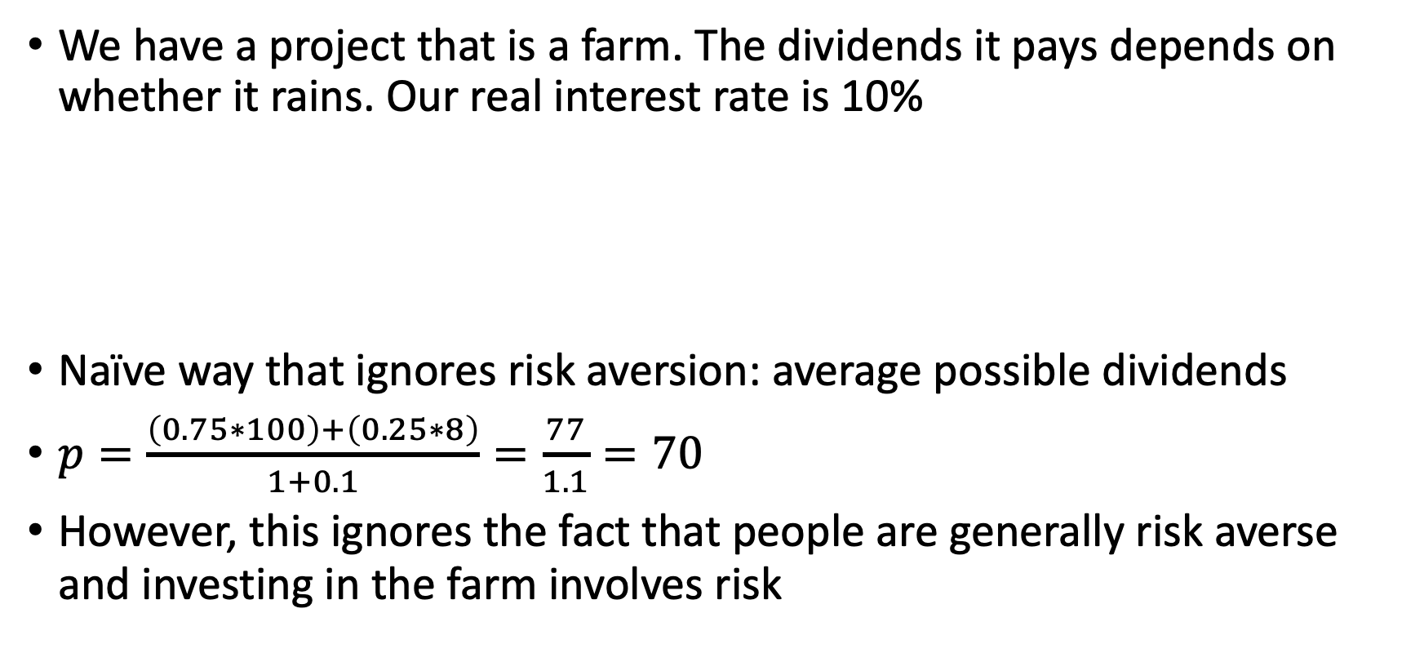
Risk
We have a project that is a farm. The dividends it pays depends on whether it rains. Our real interest rate is 10%
Naïve way that ignores risk aversion: average possible dividends
$p=\frac{\left(0.75∗100\right)+\left(0.25∗8\right)}{1+0.1}=\frac{77}{1.1}=70$
However, this ignores the fact that people are generally risk averse and investing in the farm involves risk
State of the World | Probability $Pr\left(s\right)$ | Dividend $d(s)$
$$s=Rain$$ | $$0.75$$ | $$100$$
$$s=Drought$$ | $$0.25$$ | $$8$$

Slide 26
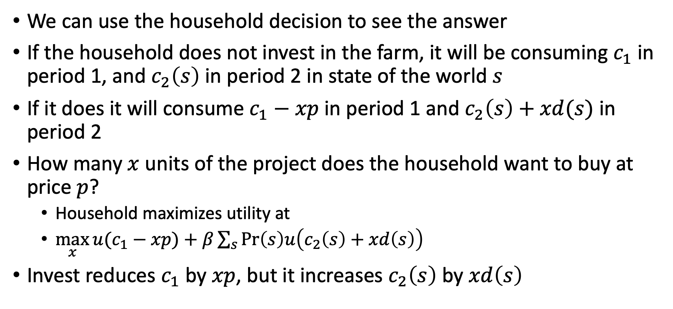
Risk
We can use the household decision to see the answer
If the household does not invest in the farm, it will be consuming $c_{1}$ in period 1, and $c_{2}\left(s\right)$ in period 2 in state of the world $s$
If it does it will consume $c_{1}−xp$ in period 1 and $c_{2}\left(s\right)+xd(s)$ in period 2
How many $x$ units of the project does the household want to buy at price $p$?
Household maximizes utility at
$\max_{x}{u(c_{1}−xp)}+β\sum_{s}{\operatorname{Pr}\left(s\right)u\left(c_{2}\left(s\right)+xd\left(s\right)\right)}$
Invest reduces $c_{1}$ by $xp$, but it increases $c_{2}\left(s\right)$ by $xd\left(s\right)$

Slide 27
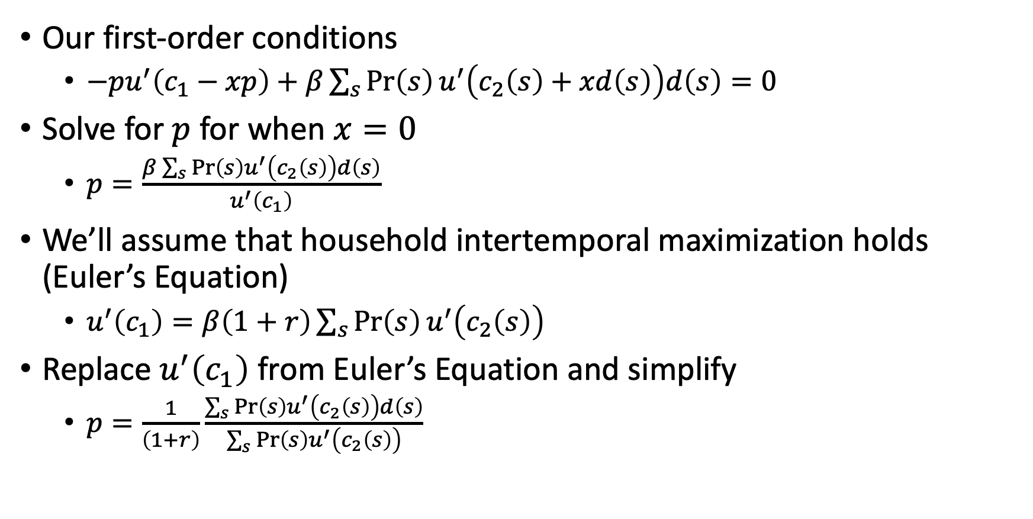
Risk
Our first-order conditions
$−pu^{′}\left(c_{1}−xp\right)+β\sum_{s}{\operatorname{Pr}\left(s\right)u^{′}\left(c_{2}\left(s\right)+xd\left(s\right)\right)d\left(s\right)=0}$
Solve for $p$ for when $x=0$
$p=\frac{β\sum_{s}{\operatorname{Pr}\left(s\right)u^{′}\left(c_{2}\left(s\right)\right)d\left(s\right)}}{u^{′}\left(c_{1}\right)}$
We’ll assume that household intertemporal maximization holds (Euler’s Equation)
$u^{′}\left(c_{1}\right)=β\left(1+r\right)\sum_{s}{\operatorname{Pr}\left(s\right)u^{′}\left(c_{2}\left(s\right)\right)}$
Replace $u^{′}\left(c_{1}\right)$ from Euler’s Equation and simplify
$p=\frac{1}{\left(1+r\right)}\frac{\sum_{s}{\operatorname{Pr}\left(s\right)u^{′}\left(c_{2}\left(s\right)\right)d\left(s\right)}}{\sum_{s}{\operatorname{Pr}\left(s\right)u^{′}\left(c_{2}\left(s\right)\right)}}$

Slide 28
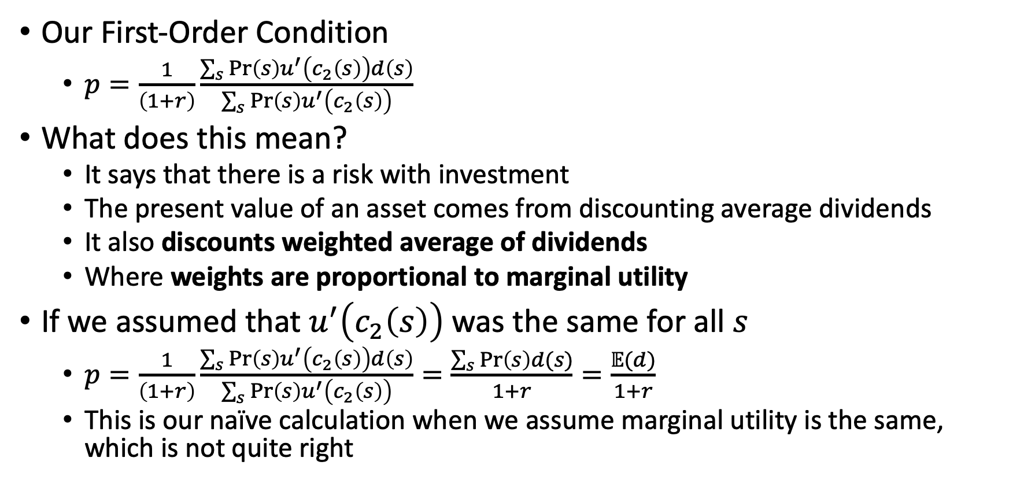
Risk
Our First-Order Condition
$p=\frac{1}{\left(1+r\right)}\frac{\sum_{s}{\operatorname{Pr}\left(s\right)u^{′}\left(c_{2}\left(s\right)\right)d\left(s\right)}}{\sum_{s}{\operatorname{Pr}\left(s\right)u^{′}\left(c_{2}\left(s\right)\right)}}$
What does this mean?
It says that there is a risk with investment
The present value of an asset comes from discounting average dividends
It also discounts weighted average of dividends
Where weights are proportional to marginal utility
If we assumed that $u^{′}\left(c_{2}\left(s\right)\right)$ was the same for all $s$
$p=\frac{1}{\left(1+r\right)}\frac{\sum_{s}{\operatorname{Pr}\left(s\right)u^{′}\left(c_{2}\left(s\right)\right)d\left(s\right)}}{\sum_{s}{\operatorname{Pr}\left(s\right)u^{′}\left(c_{2}\left(s\right)\right)}}=\frac{\sum_{s}{\operatorname{Pr}\left(s\right)d(s)}}{1+r}=\frac{𝔼(d)}{1+r}$
This is our naïve calculation when we assume marginal utility is the same, which is not quite right

Slide 29
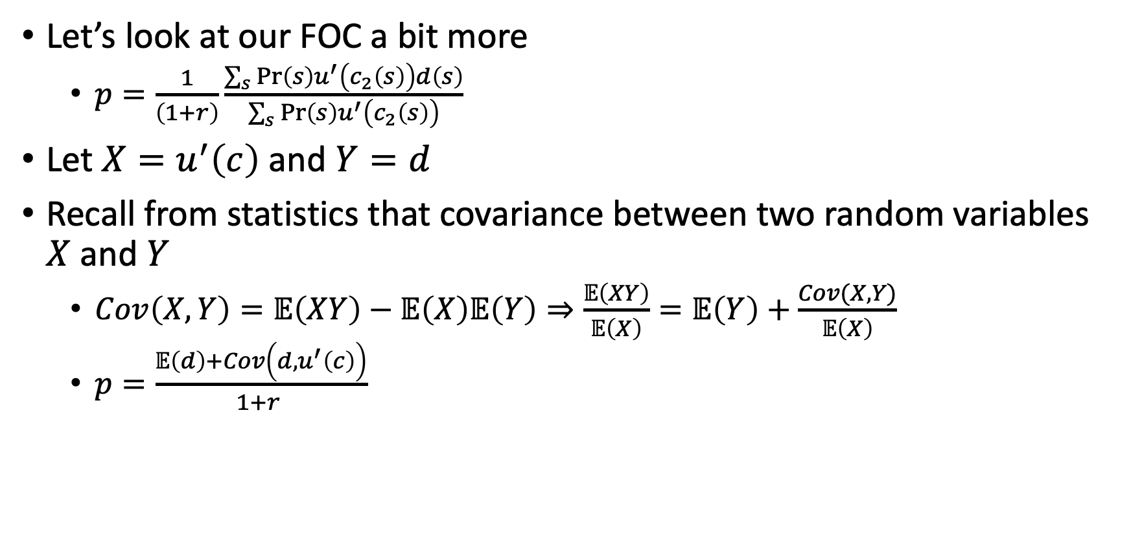
Risk
Let’s look at our FOC a bit more
$p=\frac{1}{\left(1+r\right)}\frac{\sum_{s}{\operatorname{Pr}\left(s\right)u^{′}\left(c_{2}\left(s\right)\right)d\left(s\right)}}{\sum_{s}{\operatorname{Pr}\left(s\right)u^{′}\left(c_{2}\left(s\right)\right)}}$
Let $X=u^{′}\left(c\right)$ and $Y=d$
Recall from statistics that covariance between two random variables $X$ and $Y$
$Cov\left(X,Y\right)=𝔼\left(XY\right)−𝔼\left(X\right)𝔼\left(Y\right)⇒\frac{𝔼\left(XY\right)}{𝔼\left(X\right)}=𝔼\left(Y\right)+\frac{Cov(X,Y)}{𝔼\left(X\right)}$
$p=\frac{𝔼\left(d\right)+Cov\left(d,u^{′}\left(c\right)\right)}{1+r }$

Slide 30
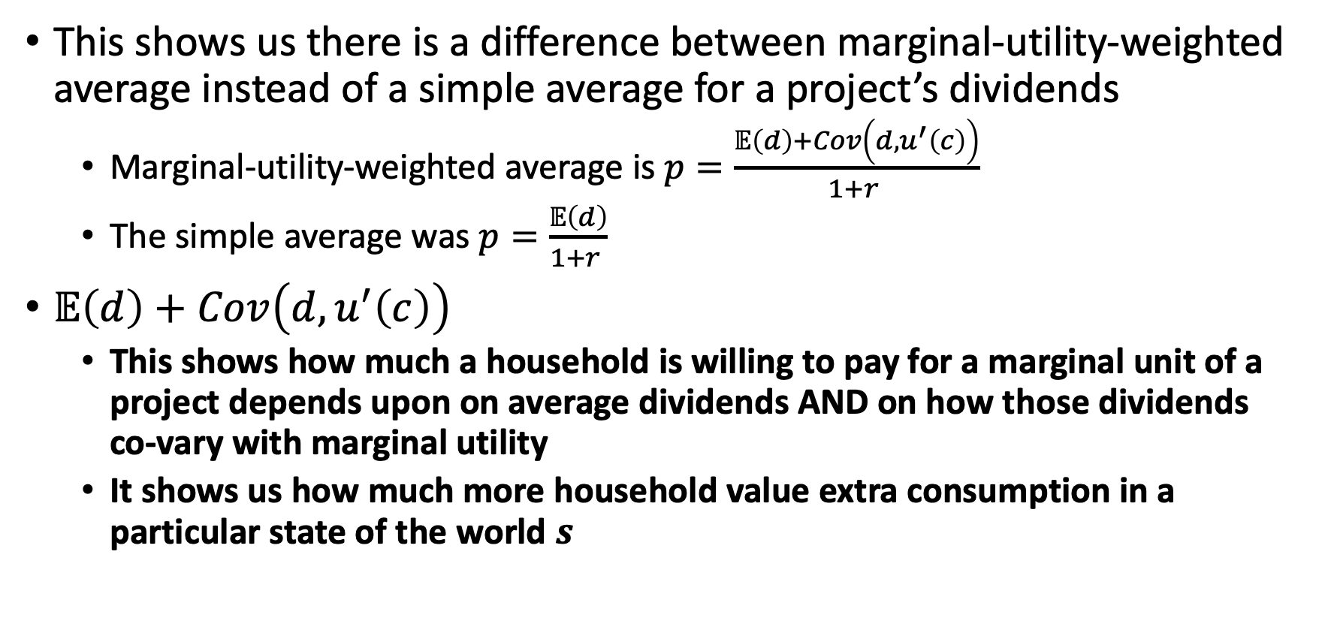
Risk
This shows us there is a difference between marginal-utility-weighted average instead of a simple average for a project’s dividends
Marginal-utility-weighted average is $p=\frac{𝔼\left(d\right)+Cov\left(d,u^{′}\left(c\right)\right)}{1+r }$
The simple average was $p=\frac{𝔼\left(d\right)}{1+r }$
$𝔼\left(d\right)+Cov\left(d,u^{′}\left(c\right)\right)$
This shows how much a household is willing to pay for a marginal unit of a project depends upon on average dividends AND on how those dividends co-vary with marginal utility
It shows us how much more household value extra consumption in a particular state of the world $s$

Slide 31
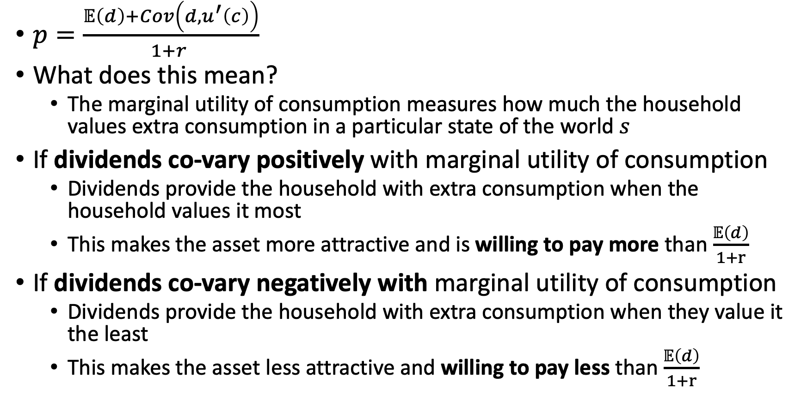
Risk
$p=\frac{𝔼\left(d\right)+Cov\left(d,u^{′}\left(c\right)\right)}{1+r }$
What does this mean?
The marginal utility of consumption measures how much the household values extra consumption in a particular state of the world $s$
If dividends co-vary positively with marginal utility of consumption
Dividends provide the household with extra consumption when the household values it most
This makes the asset more attractive and is willing to pay more than $\frac{𝔼\left(d\right)}{1+r}$
If dividends co-vary negatively with marginal utility of consumption
Dividends provide the household with extra consumption when they value it the least
This makes the asset less attractive and willing to pay less than $\frac{𝔼\left(d\right)}{1+r}$

Slide 32
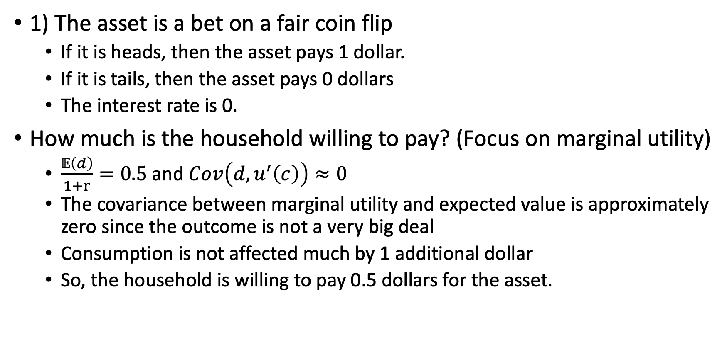
Risk Examples
1) The asset is a bet on a fair coin flip
If it is heads, then the asset pays 1 dollar.
If it is tails, then the asset pays 0 dollars
The interest rate is 0.
How much is the household willing to pay? (Focus on marginal utility)
$\frac{𝔼\left(d\right)}{1+r}=0.5$ and $Cov\left(d,u^{′}\left(c\right)\right)≈0$
The covariance between marginal utility and expected value is approximately zero since the outcome is not a very big deal
Consumption is not affected much by 1 additional dollar
So, the household is willing to pay 0.5 dollars for the asset.

Slide 33
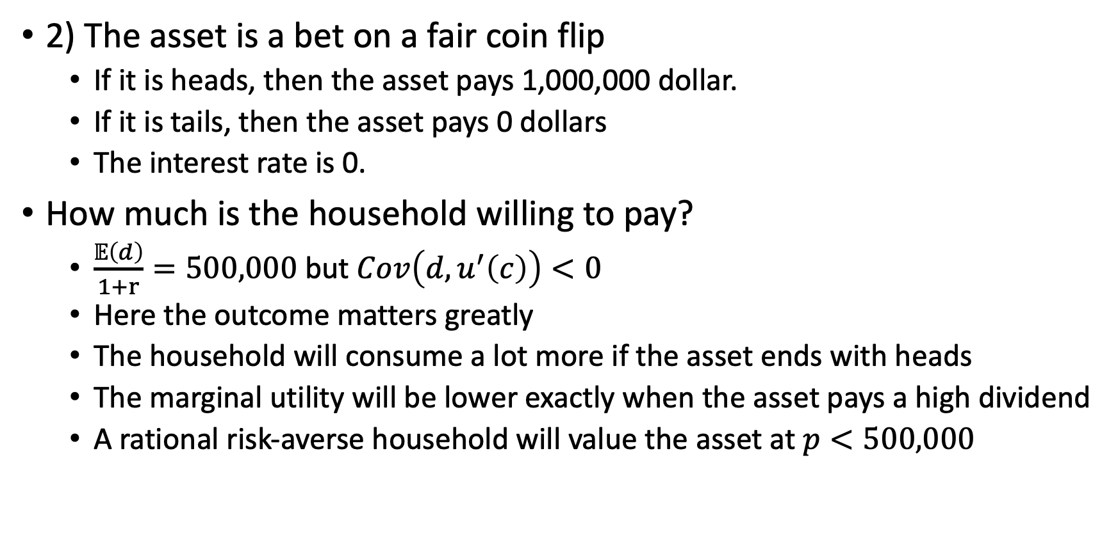
Risk Examples
2) The asset is a bet on a fair coin flip
If it is heads, then the asset pays 1,000,000 dollar.
If it is tails, then the asset pays 0 dollars
The interest rate is 0.
How much is the household willing to pay?
$\frac{𝔼\left(d\right)}{1+r}=500,000$ but $Cov\left(d,u^{′}\left(c\right)\right)<0$
Here the outcome matters greatly
The household will consume a lot more if the asset ends with heads
The marginal utility will be lower exactly when the asset pays a high dividend
A rational risk-averse household will value the asset at $p<500,000$

Slide 34
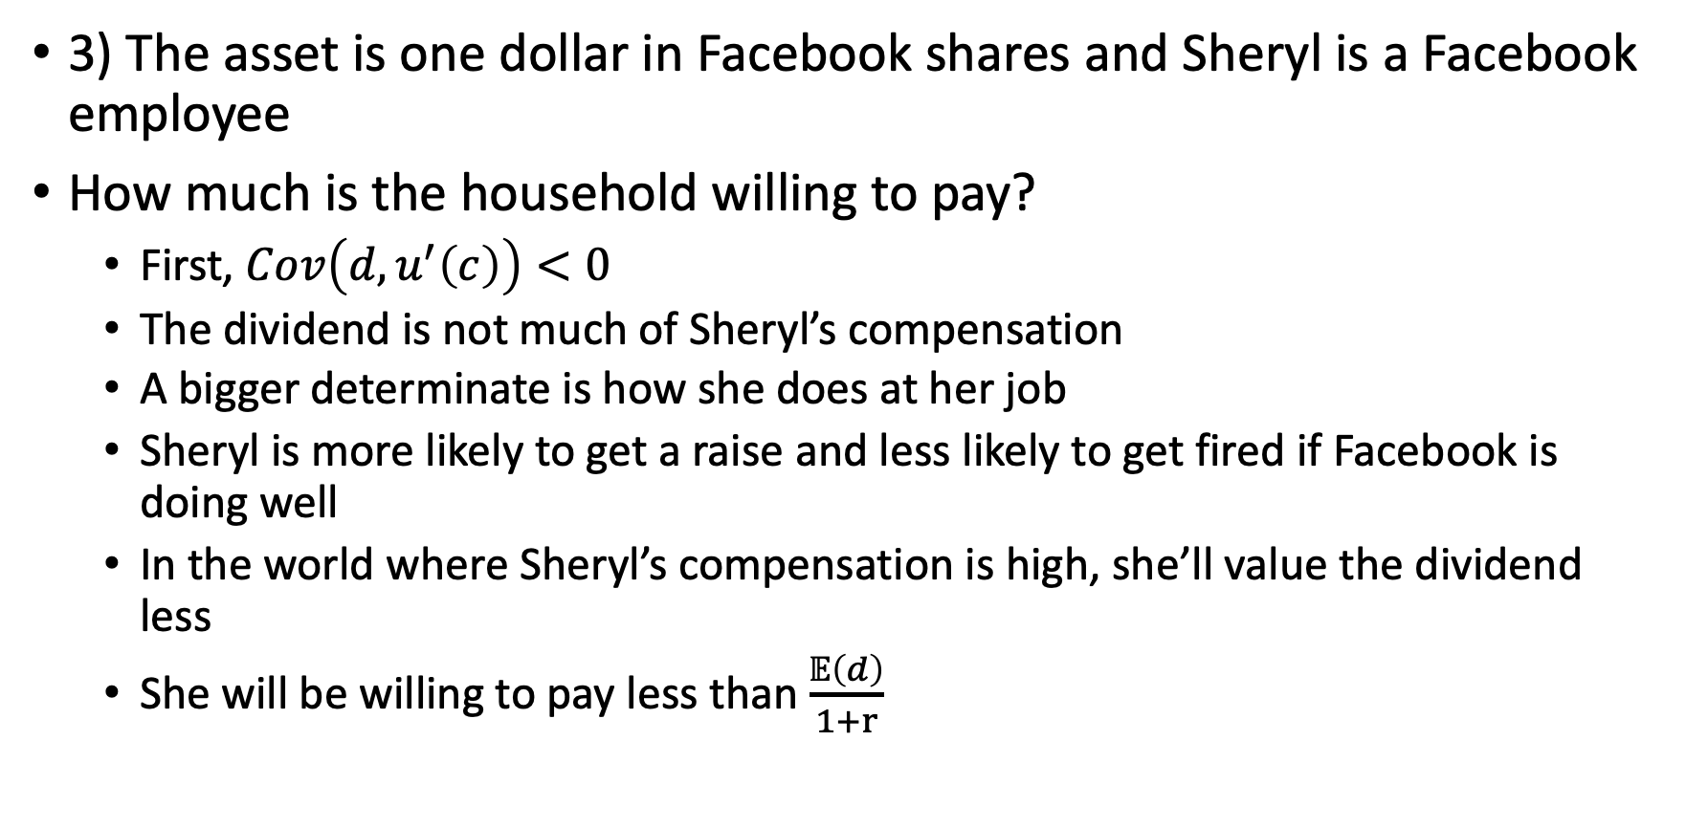
Risk Examples
3) The asset is one dollar in Facebook shares and Sheryl is a Facebook employee
How much is the household willing to pay?
First, $Cov\left(d,u^{′}\left(c\right)\right)<0$
The dividend is not much of Sheryl’s compensation
A bigger determinate is how she does at her job
Sheryl is more likely to get a raise and less likely to get fired if Facebook is doing well
In the world where Sheryl’s compensation is high, she’ll value the dividend less
She will be willing to pay less than $\frac{𝔼\left(d\right)}{1+r}$

Slide 35
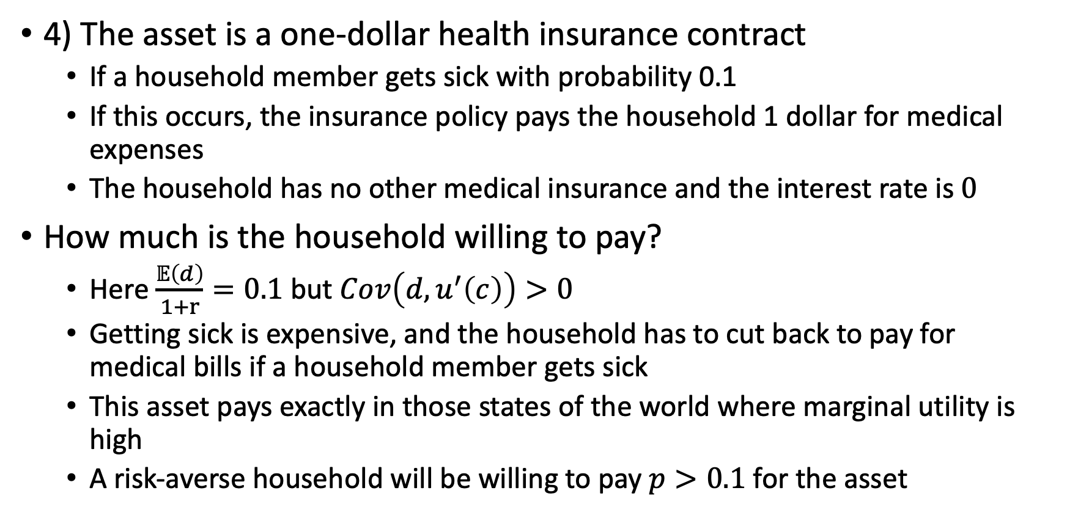
Risk Examples
4) The asset is a one-dollar health insurance contract
If a household member gets sick with probability 0.1
If this occurs, the insurance policy pays the household 1 dollar for medical expenses
The household has no other medical insurance and the interest rate is $0$
How much is the household willing to pay?
Here $\frac{𝔼\left(d\right)}{1+r}=0.1$ but $Cov\left(d,u^{′}\left(c\right)\right)>0$
Getting sick is expensive, and the household has to cut back to pay for medical bills if a household member gets sick
This asset pays exactly in those states of the world where marginal utility is high
A risk-averse household will be willing to pay $p>0.1$ for the asset

Slide 36
Marginal Product of Capital, Investment Demand Schedule, and Aggregate Investment

Slide 37
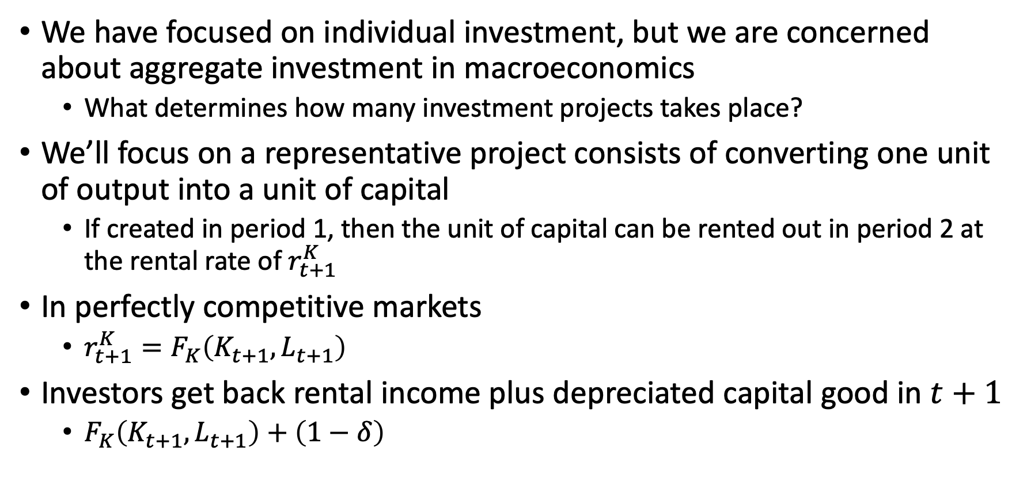
Marginal Product of Capital and Investment
We have focused on individual investment, but we are concerned about aggregate investment in macroeconomics
What determines how many investment projects takes place?
We’ll focus on a representative project consists of converting one unit of output into a unit of capital
If created in period 1, then the unit of capital can be rented out in period 2 at the rental rate of $r_{t+1}^{K}$
In perfectly competitive markets
$r_{t+1}^{K}=F_{K}\left(K_{t+1},L_{t+1}\right)$
Investors get back rental income plus depreciated capital good in $t+1$
$F_{K}\left(K_{t+1},L_{t+1}\right)+\left(1−δ\right)$

Slide 38
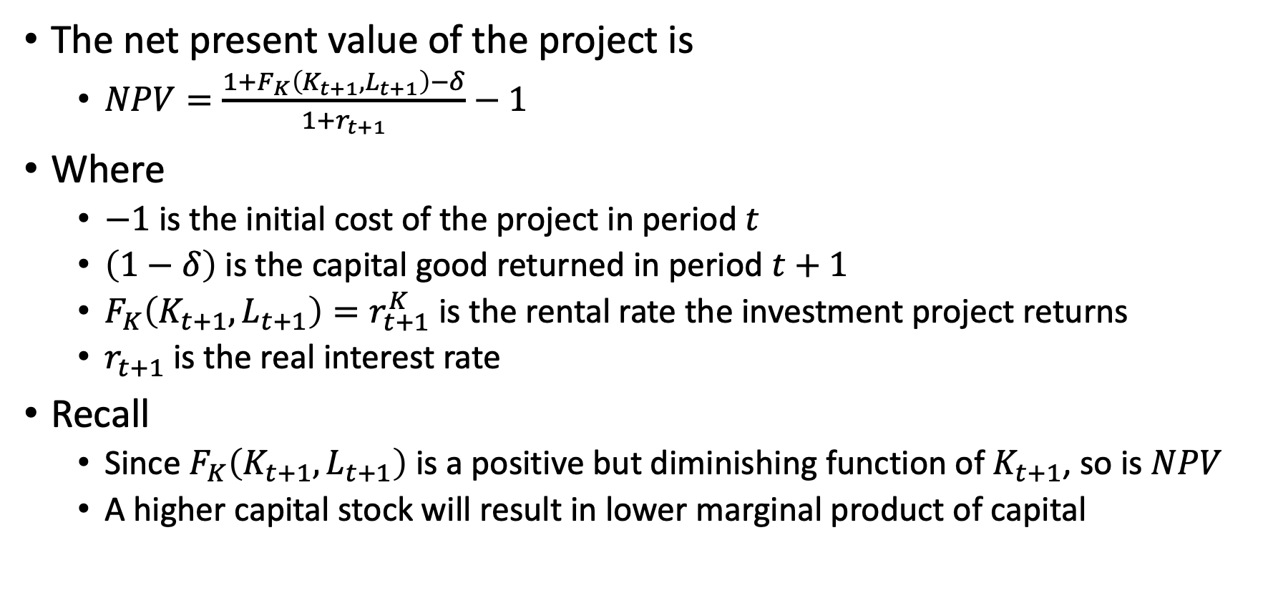
Marginal Product of Capital and Investment
The net present value of the project is
$NPV=\frac{1+F_{K}\left(K_{t+1},L_{t+1}\right)−δ}{1+r_{t+1}}−1$
Where
$−1$ is the initial cost of the project in period $t$
$\left(1−δ\right)$ is the capital good returned in period $t+1$
$F_{K}\left(K_{t+1}, L_{t+1}\right)=r_{t+1}^{K}$ is the rental rate the investment project returns
$r_{t+1}$ is the real interest rate
Recall
Since $F_{K}\left(K_{t+1}, L_{t+1}\right)$ is a positive but diminishing function of $K_{t+1}$, so is $NPV$
A higher capital stock will result in lower marginal product of capital

Slide 39
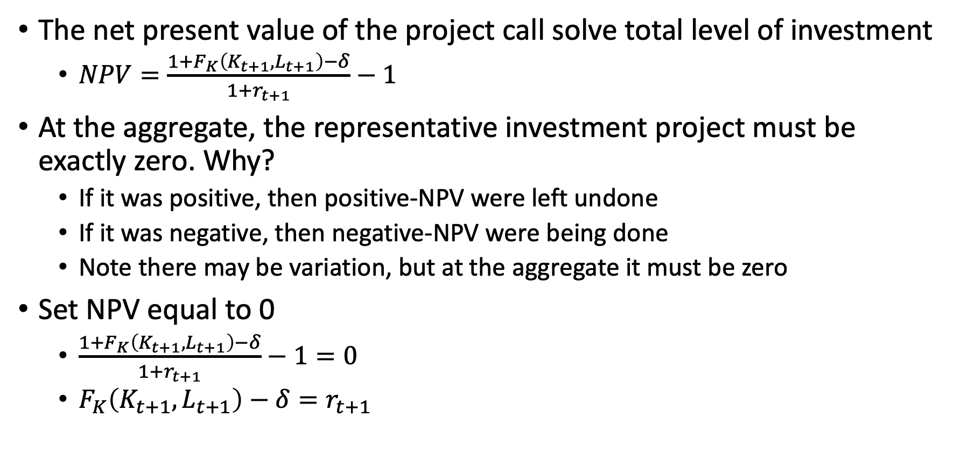
Marginal Product of Capital and Investment
The net present value of the project call solve total level of investment
$NPV=\frac{1+F_{K}\left(K_{t+1},L_{t+1}\right)−δ}{1+r_{t+1}}−1$
At the aggregate, the representative investment project must be exactly zero. Why?
If it was positive, then positive-NPV were left undone
If it was negative, then negative-NPV were being done
Note there may be variation, but at the aggregate it must be zero
Set NPV equal to 0
$\frac{1+F_{K}\left(K_{t+1},L_{t+1}\right)−δ}{1+r_{t+1}}−1=0$
$F_{K}\left(K_{t+1},L_{t+1}\right)−δ=r_{t+1}$

Slide 40
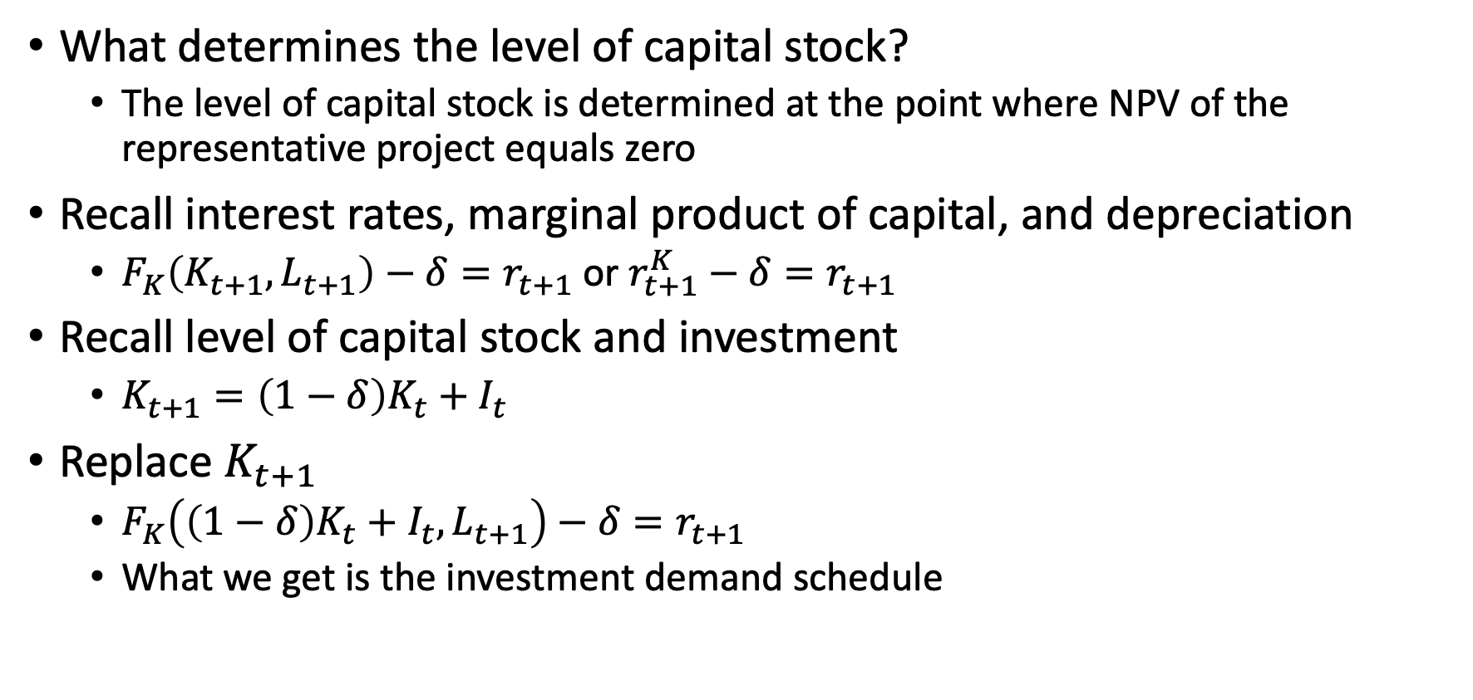
Marginal Product of Capital and Investment
What determines the level of capital stock?
The level of capital stock is determined at the point where NPV of the representative project equals zero
Recall interest rates, marginal product of capital, and depreciation
$F_{K}\left(K_{t+1},L_{t+1}\right)−δ=r_{t+1}$ or $r_{t+1}^{K}−δ=r_{t+1}$
Recall level of capital stock and investment
$K_{t+1}=\left(1−δ\right)K_{t}+I_{t}$
Replace $K_{t+1}$
$F_{K}\left(\left(1−δ\right)K_{t}+I_{t},L_{t+1}\right)−δ=r_{t+1}$
What we get is the investment demand schedule

Slide 41
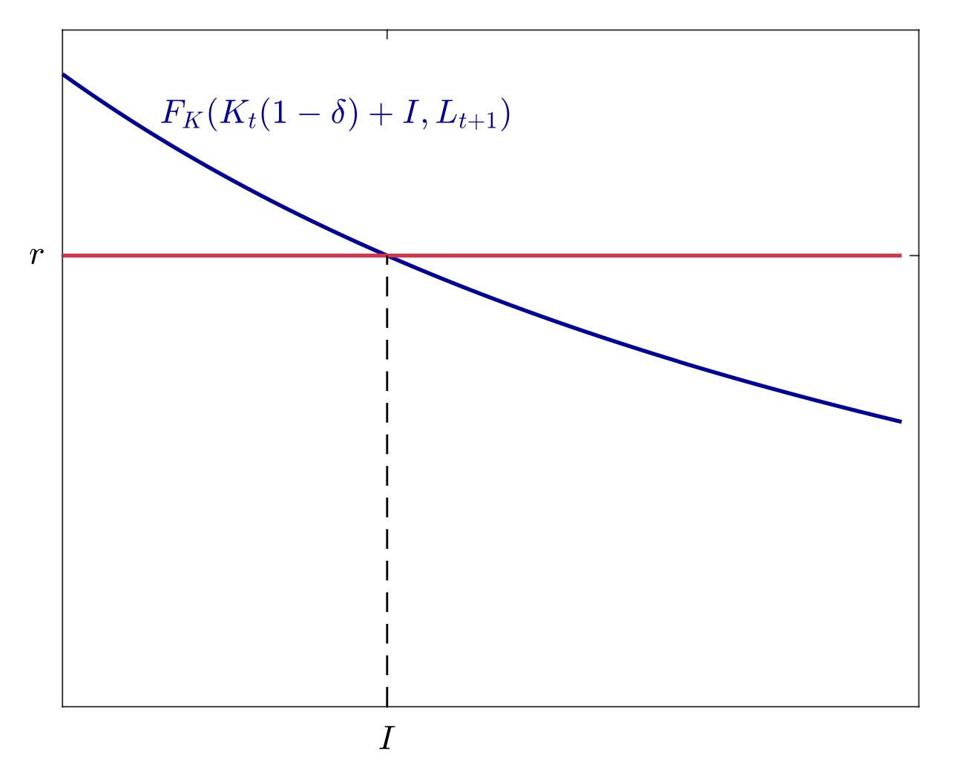
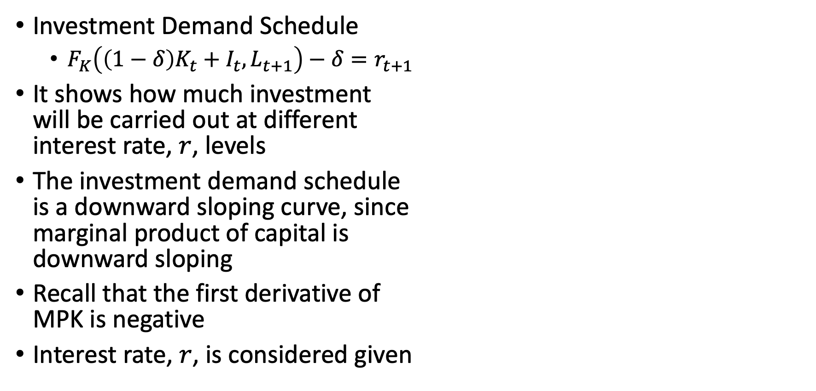
Marginal Product of Capital and Investment
Investment Demand Schedule
$F_{K}\left(\left(1−δ\right)K_{t}+I_{t},L_{t+1}\right)−δ=r_{t+1}$
It shows how much investment will be carried out at different interest rate, $r$, levels
The investment demand schedule is a downward sloping curve, since marginal product of capital is downward sloping
Recall that the first derivative of MPK is negative
Interest rate, $r$, is considered given

Slide 42
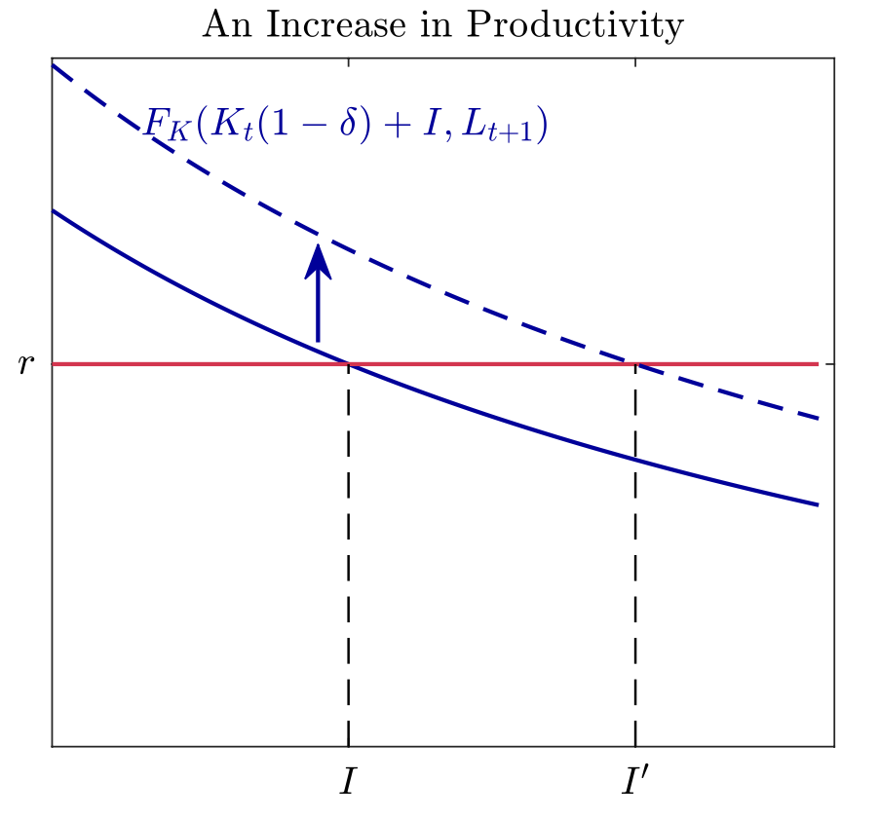
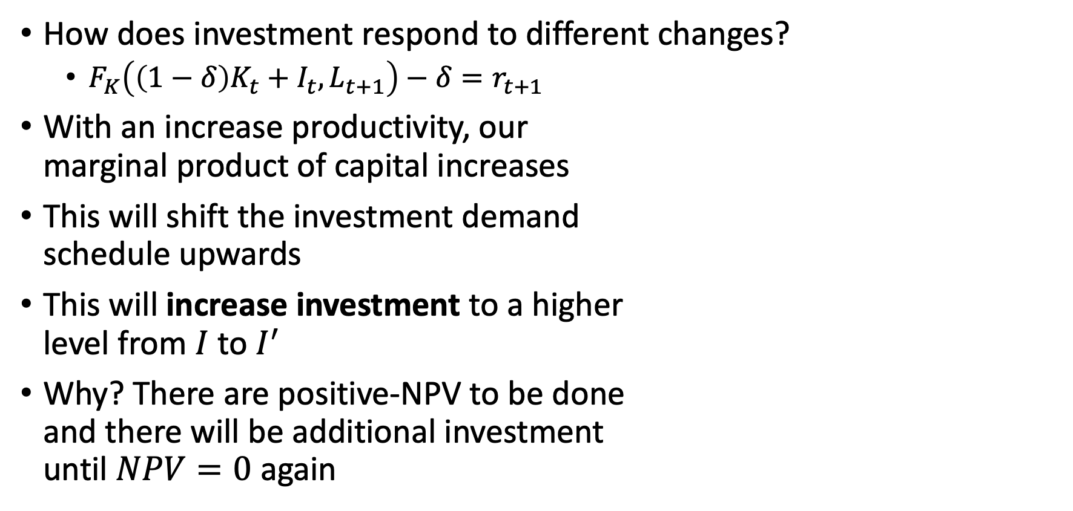
Marginal Product of Capital and Investment
How does investment respond to different changes?
$F_{K}\left(\left(1−δ\right)K_{t}+I_{t},L_{t+1}\right)−δ=r_{t+1}$
With an increase productivity, our marginal product of capital increases
This will shift the investment demand schedule upwards
This will increase investment to a higher level from $I$ to $I^{′}$
Why? There are positive-NPV to be done and there will be additional investment until $NPV=0$ again

Slide 43
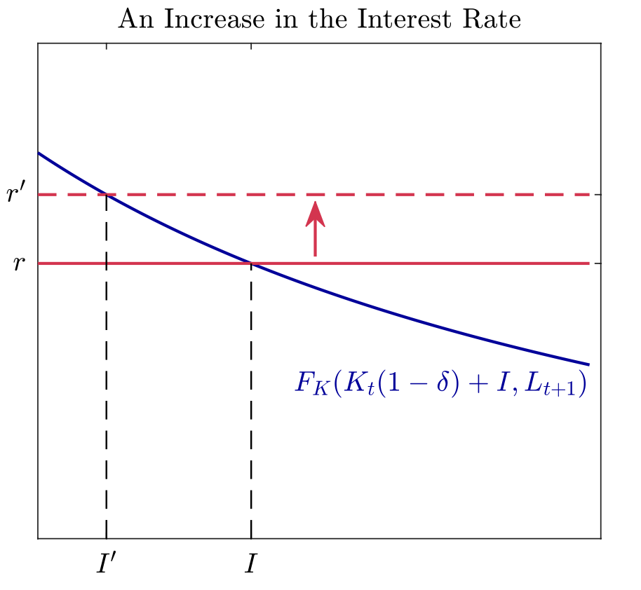
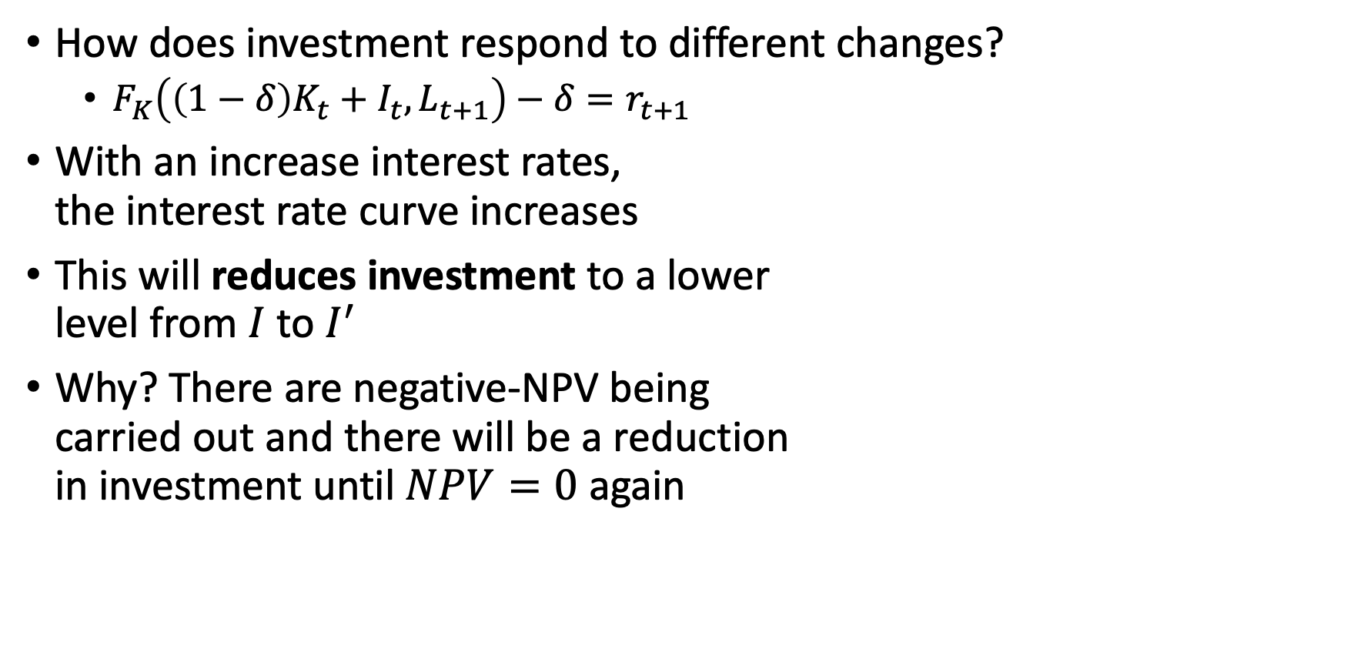
Marginal Product of Capital and Investment
How does investment respond to different changes?
$F_{K}\left(\left(1−δ\right)K_{t}+I_{t},L_{t+1}\right)−δ=r_{t+1}$
With an increase interest rates, the interest rate curve increases
This will reduces investment to a lower level from $I$ to $I^{′}$
Why? There are negative-NPV being carried out and there will be a reduction in investment until $NPV=0$ again

Slide 44
Announcements
We have class on Friday at 6:45
Presentation Group 2 is on Friday
Problem Set 3 is available and due on Friday Jan 24
Presentation Group 3 is on Tuesday, Jan 28
Please send me a copy of your slides by Saturday (1/25) or Sunday (1/26)

Slide 45
Equilibrium
Kurlat Chapter 9

Slide 46
Overview
General Equilibrium in Two-Period Economy
Bring together the household, firm, and investment firm problems
Equilibrium Definition
Describing Equilibrium
The First Welfare Theorem
Describing the First Welfare Theorem
When First Welfare Theorem does not hold
General Equilibrium in an Infinite-Period Economy
Dynamics
The Golden Rule
Anticipatory Effects

Slide 47
General Equilibrium in a Two-Period Economy

Slide 48
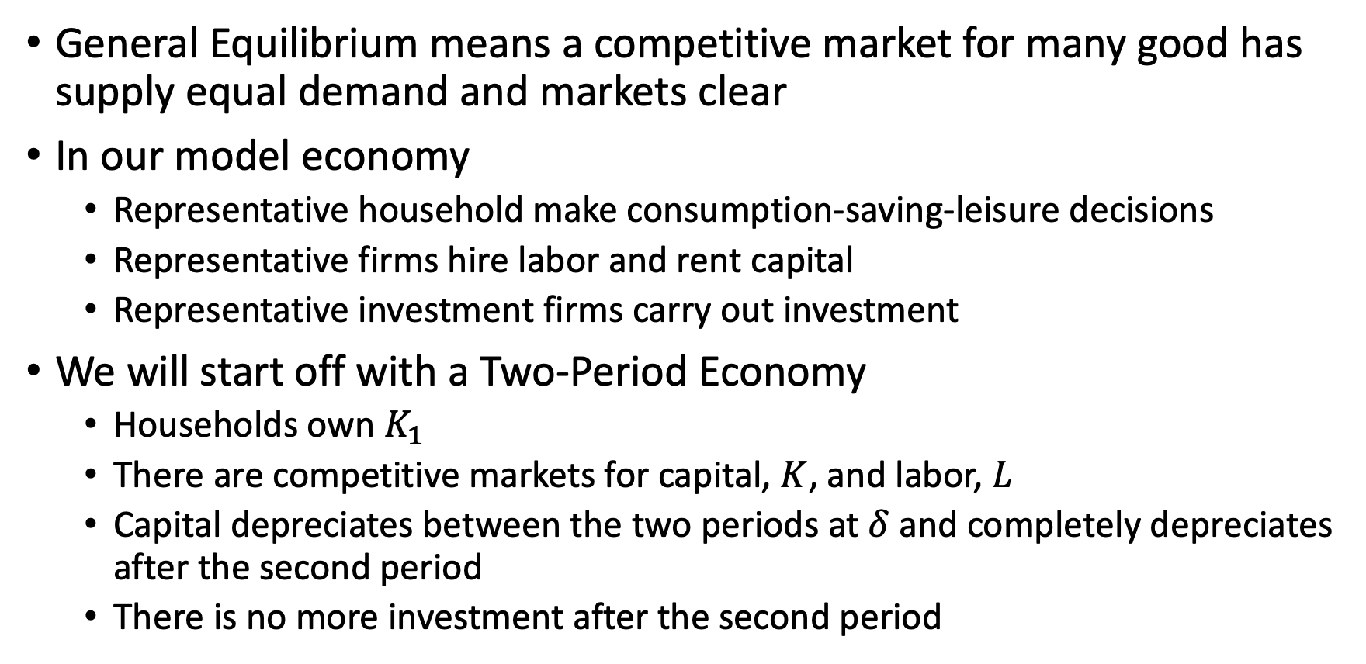
General Equilibrium in a Two-Period Economy
General Equilibrium means a competitive market for many good has supply equal demand and markets clear
In our model economy
Representative household make consumption-saving-leisure decisions
Representative firms hire labor and rent capital
Representative investment firms carry out investment
We will start off with a Two-Period Economy
Households own $K_{1}$
There are competitive markets for capital, $K$, and labor, $L$
Capital depreciates between the two periods at $δ$ and completely depreciates after the second period
There is no more investment after the second period

Slide 49
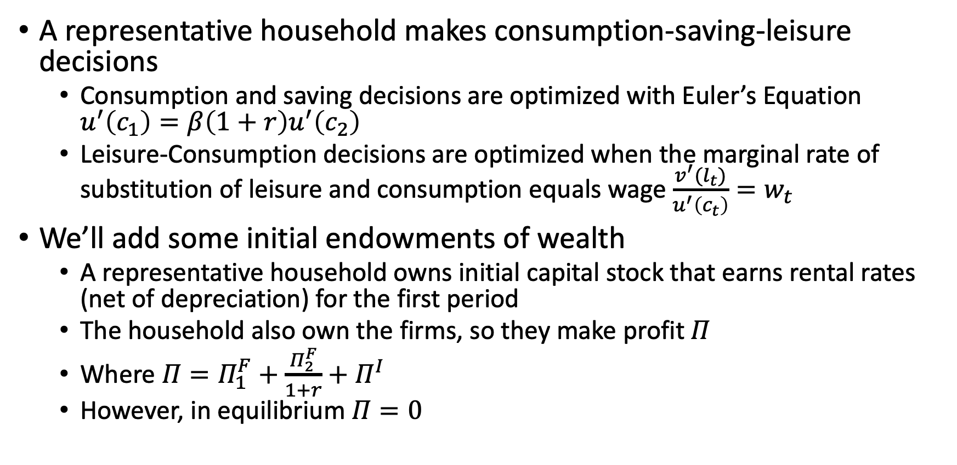
General Equilibrium in a Two-Period Economy
A representative household makes consumption-saving-leisure decisions
Consumption and saving decisions are optimized with Euler’s Equation $u^{′}\left(c_{1}\right)=β\left(1+r\right)u^{′}\left(c_{2}\right)$
Leisure-Consumption decisions are optimized when the marginal rate of substitution of leisure and consumption equals wage $\frac{v^{′}(l_{t})}{u^{′}\left(c_{t}\right)}=w_{t}$
We’ll add some initial endowments of wealth
A representative household owns initial capital stock that earns rental rates (net of depreciation) for the first period
The household also own the firms, so they make profit $Π$
Where $Π=Π_{1}^{F}+\frac{Π_{2}^{F}}{1+r}+Π^{I}$
However, in equilibrium $Π=0$

Slide 50
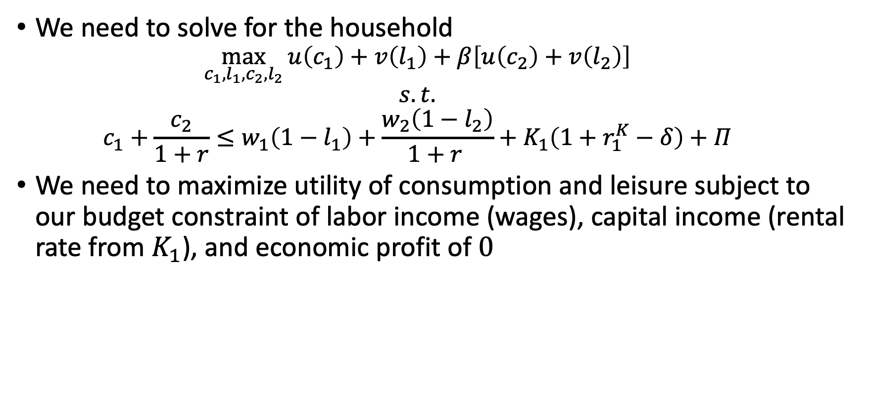
The Representative Household
We need to solve for the household
$$\max_{c_{1},l_{1},c_{2},l_{2}}{u\left(c_{1}\right)+v\left(l_{1}\right)+β\left[u\left(c_{2}\right)+v\left(l_{2}\right)\right]}$$
$$s.t.$$
$$c_{1}+\frac{c_{2}}{1+r}≤w_{1}\left(1−l_{1}\right)+\frac{w_{2}\left(1−l_{2}\right)}{1+r }+K_{1}\left(1+r_{1}^{K}−δ\right)+Π$$
We need to maximize utility of consumption and leisure subject to our budget constraint of labor income (wages), capital income (rental rate from $K_{1}$), and economic profit of $0$

Slide 51
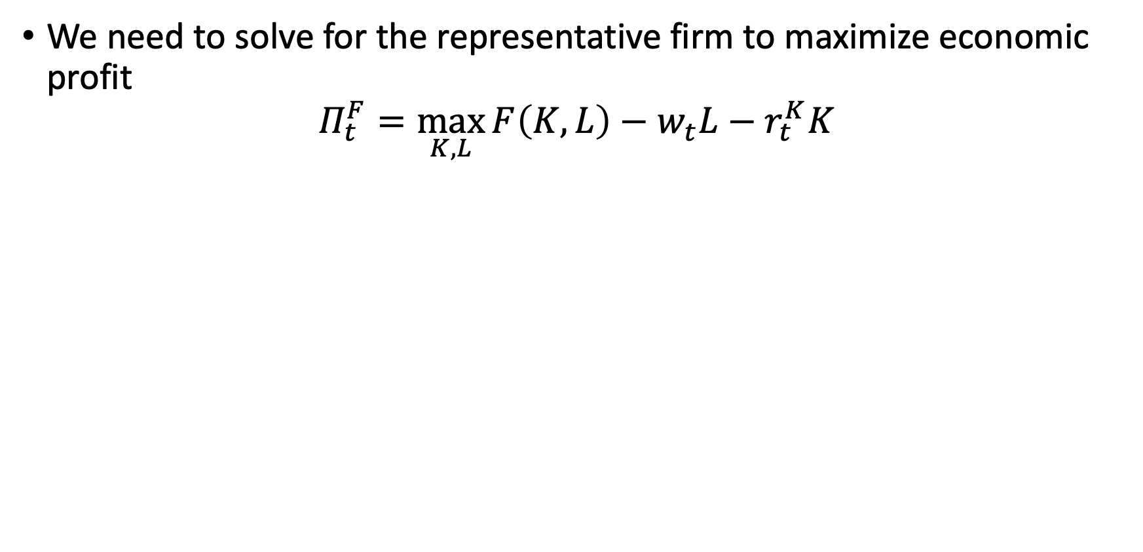
The Representative Firm
We need to solve for the representative firm to maximize economic profit
$$Π_{t}^{F}=\max_{K,L}{F\left(K,L\right)−w_{t}L−r_{t}^{K}K}$$

Slide 52
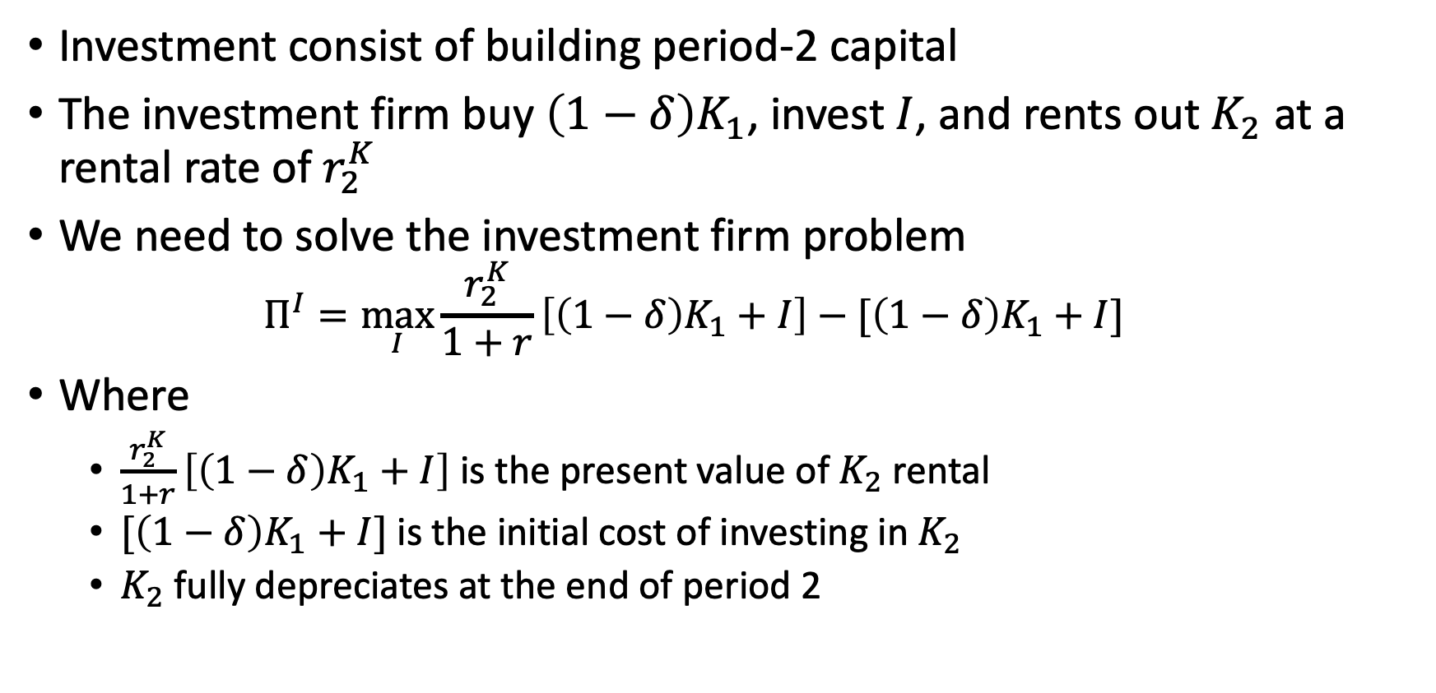
The Representative Investment Firm
Investment consist of building period-2 capital
The investment firm buy $\left(1−δ\right)K_{1}$, invest $I$, and rents out $K_{2}$ at a rental rate of $r_{2}^{K}$
We need to solve the investment firm problem
$$Π^{I}=\max_{I}{\frac{r_{2}^{K}}{1+r}\left[\left(1−δ\right)K_{1}+I\right]−[\left(1−δ\right)K_{1}+I]}$$
Where
$\frac{r_{2}^{K}}{1+r}\left[\left(1−δ\right)K_{1}+I\right]$ is the present value of $K_{2}$ rental
$[\left(1−δ\right)K_{1}+I]$ is the initial cost of investing in $K_{2}$
$K_{2}$ fully depreciates at the end of period 2

Slide 53
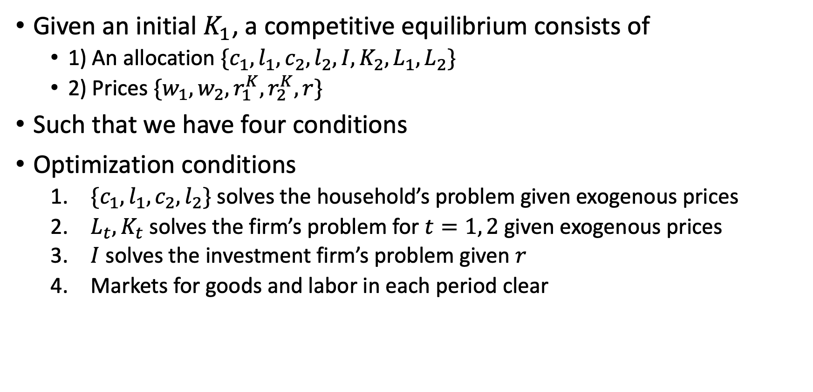
Equilibrium Definition
Given an initial $K_{1}$, a competitive equilibrium consists of
1) An allocation $\{c_{1},l_{1},c_{2},l_{2},I,K_{2},L_{1},L_{2}\}$
2) Prices $\{w_{1},w_{2},r_{1}^{K},r_{2}^{K},r\}$
Such that we have four conditions
Optimization conditions
$\{c_{1},l_{1},c_{2},l_{2}\}$ solves the household’s problem given exogenous prices
$L_{t}, K_{t}$ solves the firm’s problem for $t=1, 2$ given exogenous prices
$I$ solves the investment firm’s problem given $r$
Markets for goods and labor in each period clear

Slide 54
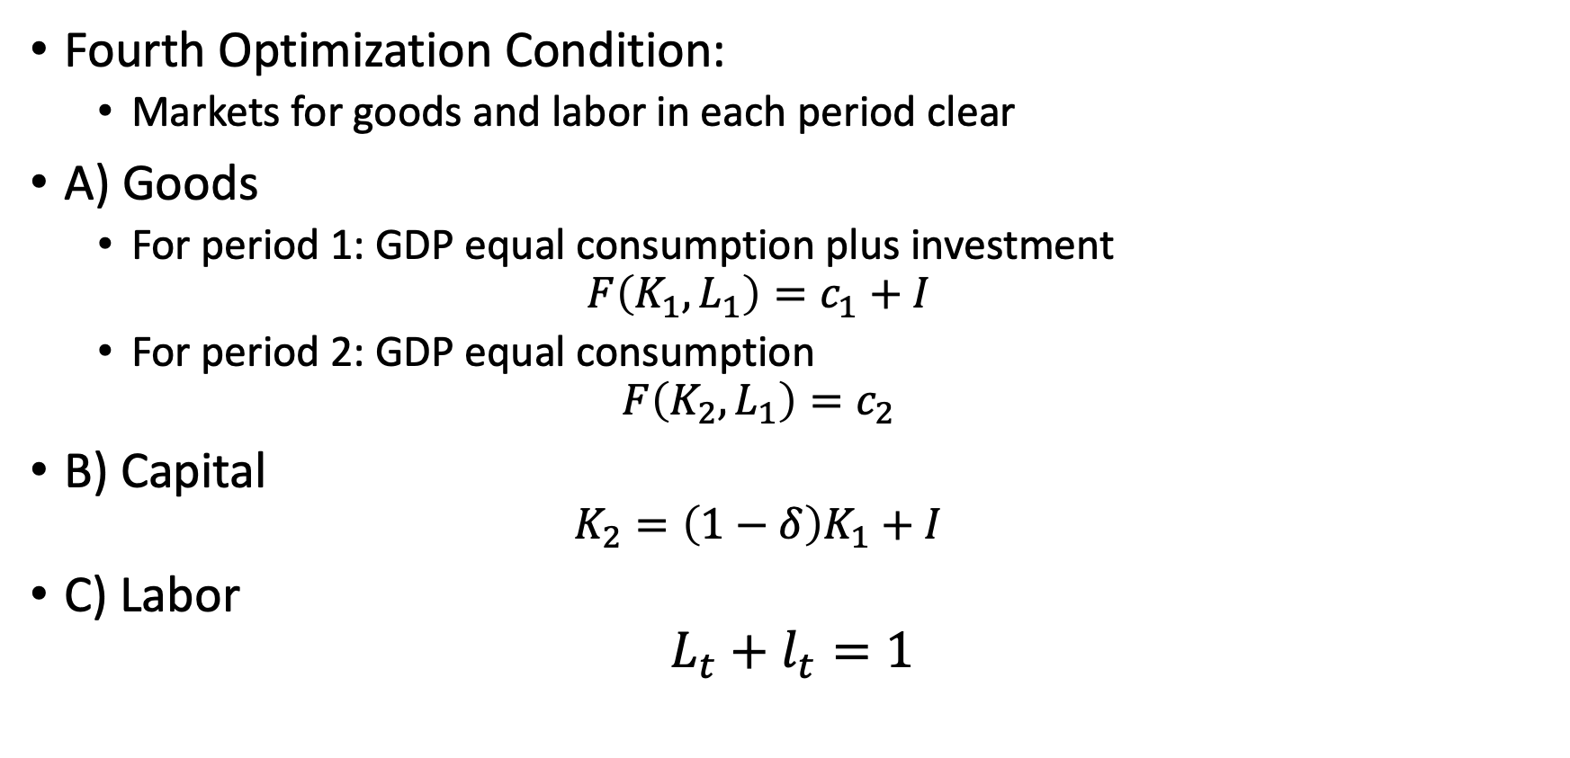
Equilibrium Definition
Fourth Optimization Condition:
Markets for goods and labor in each period clear
A) Goods
For period 1: GDP equal consumption plus investment
$$F\left(K_{1},L_{1}\right)=c_{1}+I$$
For period 2: GDP equal consumption
$$F\left(K_{2},L_{1}\right)=c_{2}$$
B) Capital
$$K_{2}=\left(1−δ\right)K_{1}+I$$
C) Labor
$$L_{t}+l_{t}=1$$

Slide 55
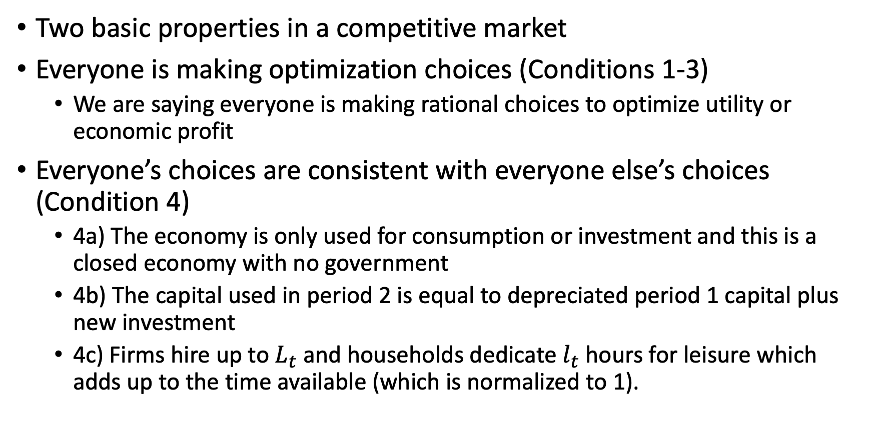
Equilibrium Definition
Two basic properties in a competitive market
Everyone is making optimization choices (Conditions 1-3)
We are saying everyone is making rational choices to optimize utility or economic profit
Everyone’s choices are consistent with everyone else’s choices (Condition 4)
4a) The economy is only used for consumption or investment and this is a closed economy with no government
4b) The capital used in period 2 is equal to depreciated period 1 capital plus new investment
4c) Firms hire up to $L_{t}$ and households dedicate $l_{t}$ hours for leisure which adds up to the time available (which is normalized to 1).

Slide 56
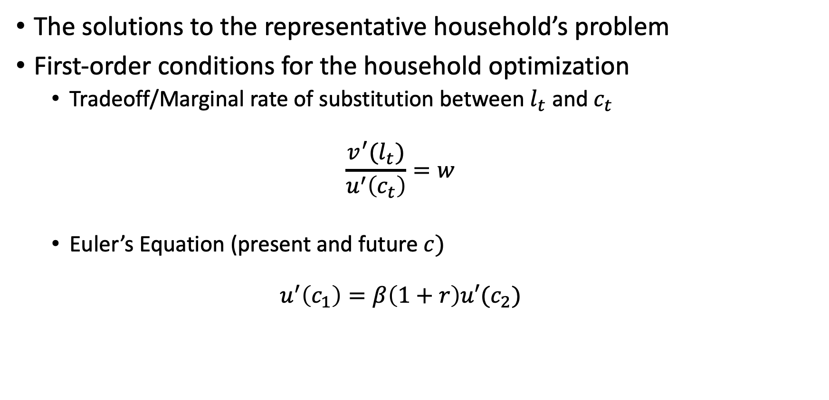
Describing an Equilibrium
The solutions to the representative household’s problem
First-order conditions for the household optimization
Tradeoff/Marginal rate of substitution between $l_{t}$ and $c_{t}$
$$\frac{v^{′}(l_{t})}{u^{′}\left(c_{t}\right)}=w$$
Euler’s Equation (present and future $c)$
$$u^{′}\left(c_{1}\right)=β\left(1+r\right)u′(c_{2})$$

Slide 57
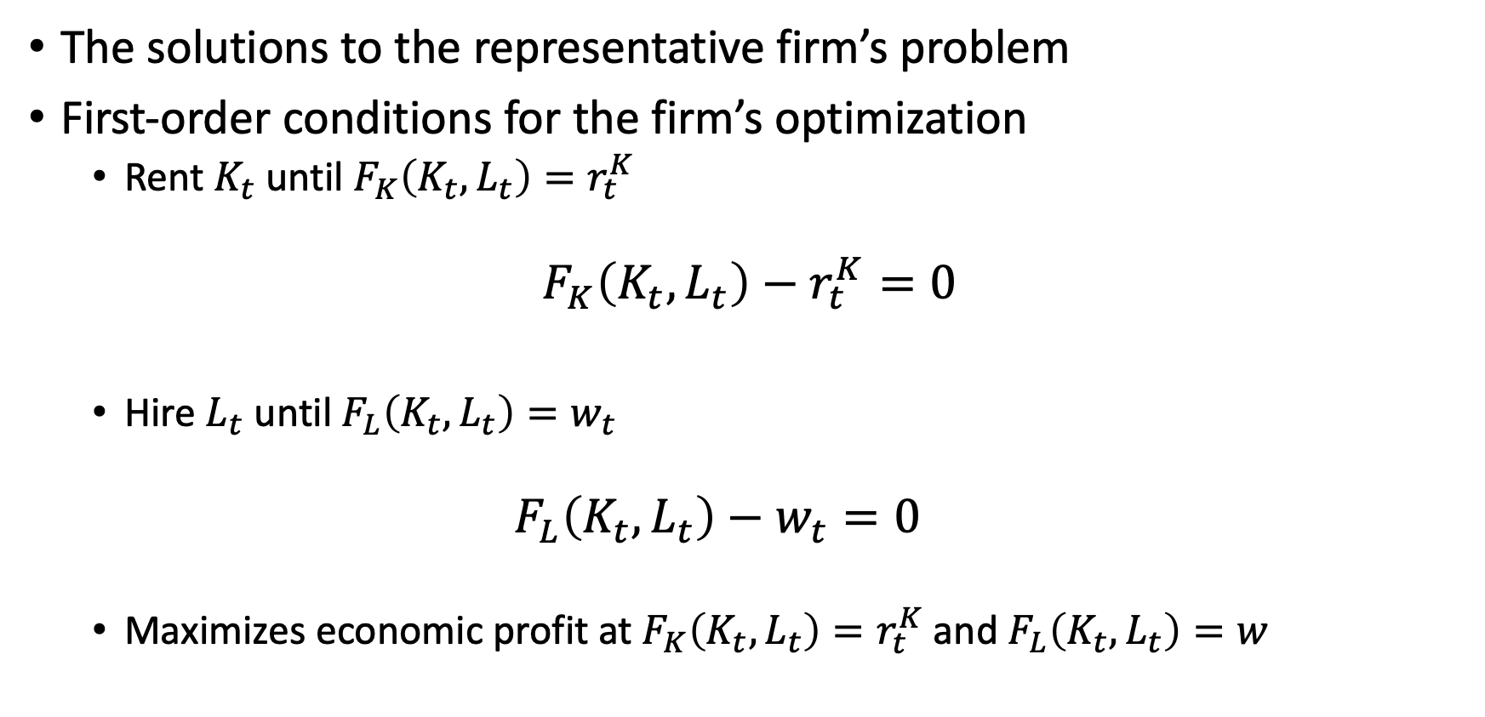
Describing an Equilibrium
The solutions to the representative firm’s problem
First-order conditions for the firm’s optimization
Rent $K_{t}$ until $F_{K}\left(K_{t},L_{t}\right)=r_{t}^{K}$
$$F_{K}\left(K_{t},L_{t}\right)−r_{t}^{K}=0$$
Hire $L_{t}$ until $F_{L}\left(K_{t}, L_{t}\right)=w_{t}$
$$F_{L}\left(K_{t},L_{t}\right)−w_{t}=0$$
Maximizes economic profit at $F_{K}\left(K_{t},L_{t}\right)=r_{t}^{K}$ and $F_{L}\left(K_{t},L_{t}\right)=w$

Slide 58
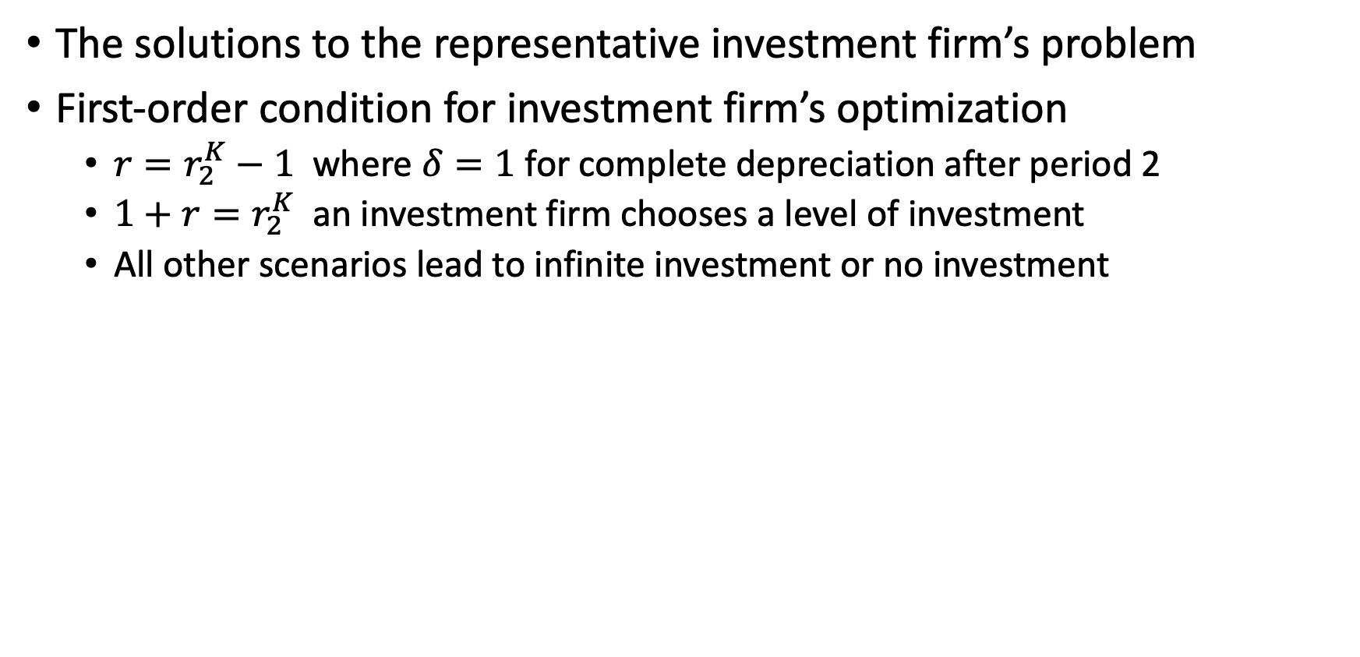
Describing an Equilibrium
The solutions to the representative investment firm’s problem
First-order condition for investment firm’s optimization
$r=r_{2}^{K}−1$ where $δ=1$ for complete depreciation after period 2
$1+r=r_{2}^{K}$ an investment firm chooses a level of investment
All other scenarios lead to infinite investment or no investment

Slide 59

Describing an Equilibrium
Equilibrium in the allocation of time (leisure vs consumption)
$$\frac{v^{′}(l_{t})}{u′\left(c_{t}\right)}=w=F_{L}(K_{t},L_{t})$$
This shows the relationship between the marginal rate of substitution between leisure and consumption with the marginal rate of transformation to convert time into output is set at the given wage rate $w$
Equilibrium in the allocation of capital and labor
$$F_{K}\left(K_{t},L_{t}\right)=r_{t}^{K}$$
$$F_{L}\left(K_{t},L_{t}\right)=w_{t}$$

Slide 60

Describing an Equilibrium
Equilibrium in present and future consumption
$$\frac{u′(c_{1})}{βu^{′}\left(c_{2}\right)}=\left(1+r\right)=F_{K}\left(K_{2},L_{2}\right)$$ This shows the relationship between the marginal rate of substitution between present and future consumption with the marginal rate of transformation of current output into future output is set at the interest rate $(1+r)$
Equilibrium is summarized by these two equations
$\frac{v^{′}(l_{t})}{u^{′}\left(c_{t}\right)} =w=F_{L}(K_{t},L_{t})$
$\frac{u^{′}\left(c_{1}\right)}{βu^{′}\left(c_{2}\right)}=\left(1+r\right)=F_{K}\left(K_{2},L_{2}\right)$

Slide 61
The First Welfare Theorem

Slide 62
The First Welfare Theorem
What if we could choose a different allocation of goods, labor, and investment besides the competitive equilibrium?
The First Welfare Theorem states that an allocation of goods, labor, and investment in competitive equilibrium will be Pareto Optimal
Pareto Optimal means that there is no technologically feasible way to make someone better off without making someone else worse off

Slide 63
The First Welfare Theorem
Let’s imagine a benevolent social planner and all households and firms delegate decisions to the social planner to optimize utility/welfare
How can this social planner allocate resources?
The social planner is benevolent
The social planner is powerful
The social planner is constrained by technological possibilities of the economy

Slide 64

The First Welfare Theorem
The social planner solves the following problem
$$\max_{\left(c_{1},l_{1},c_{2},l_{2},L_{1},L_{2},K_{2}\right)}{u\left(c_{1}\right)+v\left(l_{1}\right)+β\left[u\left(c_{2}\right)+v\left(l_{2}\right)\right]}$$
$$s.t.$$
$$K_{2}≤\left(1−δ\right)K_{1}+F\left(K_{1},L_{1}\right)−c_{1}$$
$$c_{2}≤F(K_{2},L_{2})$$
$$L_{t}≤1−l_{t} for t=1,2$$
$$K_{1} is exogenuous$$
The solution to the social planner’s problem to maximize utility/well-being/welfare is the same as the solution defined in the competitive market equilibrium

Slide 65

The First Welfare Theorem
The First Welfare Theorem
states an allocation $\left\{c_{1},l_{1},c_{2},l_{2},I,K_{2},L_{1},L_{2}\right\}$ is part of a competitive equilibrium, then it solves the social planner’s problem to maximize society’s utility/well-being/welfare
Why?
The social planner chooses an allocation that maximizes utility subject to the constraints of technological possibilities
In competitive equilibrium, each household maximizes utility subject to prices, such as wages, rental rates, and interest rates
Where prices reflect technological possibilities

Slide 66
The First Welfare Theorem
We can generalize the results of the First Welfare Theorem
It can still hold if
There can be many different goods at each date (e.g.: apples, oranges, etc.) instead of just general consumption
There is exogenous technological progress
Uncertainty can exist as long as markets are complete at competitive prices (no asymmetric information)
There can be heterogeneous households with different tastes, preferences, abilities, and wealth
There is no unique way to define the social planner’s problem, since the social planner would have to decide how much utility each different household matters
The First Welfare Theorem can be summarized as
If an allocation is part of a competitive equilibrium then it is Pareto Optimal
Pareto Optimal means that there is no technological feasible way to make someone better off without making someone else worse off

Slide 67
The First Welfare Theorem
The First Welfare Theorem is extremely useful for thinking about public policy
If we have a competitive equilibrium, then any policy that makes a household better off will make another household worse off
Here is where the fun begins: when does this fail?
The conditions for the First Welfare Theorem to hold are strict and unlikely to hold in reality
What are some conditions that violate it?
Externalities (Positive and Negative)
Monopolies, Monopsonies, Natural Monopolies, Thin Markets
Asymmetric Information, Moral Hazard, Adverse Selection
Public Goods (Nonexcludable, non-rivalrous, or both)

Slide 68
General Equilibrium in an Infinite-Period Economy

Slide 69

General Equilibrium in an Infinite-Period
We will expand our model from a two-period economy to an infinite-period economy
Describe the household’s, firm’s, and investment firm’s problems and equilibrium
The representative household’s problem
$$\max_{c_{t},l_{t},a_{t+1}}{\sum_{t=0}^{∞}{β^{t}\left[u\left(c_{t}\right)+v\left(l_{t}\right)\right] }}$$
$$s.t.$$
$a_{t+1}=\left(1+r_{t}\right)a_{t}+w_{t}\left(1−l_{t}\right)+Π_{t}^{F}+Π_{t}^{I}−c_{t}$ and $a_{0}=K_{0}\left(1+r_{0}^{K}−δ\right)$
Where a household income is $\left(1+r_{t}\right)a_{t}+w_{t}\left(1−l_{t}\right)+Π_{t}^{F}+Π_{t}^{I}$
Where initial endowment of capital is $K_{0}$

Slide 70

General Equilibrium in an Infinite-Period
The representative firm’s problem remains unchanged to maximize economic profits
$$Π_{t}^{F}=\max_{K_{t},L_{t}}{F\left(K_{t},L_{t}\right)−w_{t}L_{t}−r_{t}^{K}K_{t}}$$
The investment firm’s problem is similar but capital does not complete depreciate at the end of the second period
$$Π_{t}^{I}=\max_{I}\frac{r_{t+1}^{K}+1−δ}{1+r_{t+1}}\left[\left(1−δ\right)K_{t}+I\right]−\left[K_{t}\left(1−δ\right)+I\right]$$

Slide 71

General Equilibrium in an Infinite-Period
A competitive equilibrium consists of:
An allocation ${\left\{c_{t},l_{t},I_{t},K_{t+1},L_{t}\right\}}_{t=0}^{∞}$
Prices ${\left\{w_{t},r_{t}^{K},r_{t}\right\}}_{t=0}^{∞}$
Such that optimization is
${\left\{c_{t},l_{t}\right\}}_{t=0}^{∞}$ solves the household utility maximization problem
$L_{t},K_{t}$ solves the firm’s economic profit maximization problem every $t$
$I_{t}$ solves the investment firms economic profit maximization problem in $t$
Markets clear each period with
Goods: $F\left(K_{t},L_{t}\right)=c_{t}+I_{t}$
Capital: $K_{t+1}=\left(1−δ\right)K_{t}+I_{t}$
Labor: $L_{t}+l_{t}=1$

Slide 72

General Equilibrium in an Infinite-Period
This is similar to our two-period economy
First order conditions for the representative household are
$\frac{v^{′}(l_{t})}{u^{′}(c_{t})}=w$ and $u^{′}\left(c_{t}\right)=β\left(1+r_{t+1}\right)u^{′}\left(c_{t+1}\right)$
First order conditions for the representative firm are
$F_{K}\left(K_{t},L_{t}\right)=r_{t}^{K}$ and $F_{L}\left(K_{t},L_{t}\right)=w_{t}$
First order conditions for the representative investment firm are
$$r_{t+1}=r_{t+1}^{K}−δ$$
Our two main equations remain similar
$\frac{v^{′}\left(l_{t}\right)}{u^{′}\left(c_{t}\right)}=w=F_{L}\left(K_{t},L_{t}\right)$
$\frac{u^{′}\left(c_{t}\right)}{βu^{′}\left(c_{t+1}\right)}=\left(1+r_{t+1}\right)=\left(1+F_{K}\left(K_{t+1},L_{t+1}\right)−δ\right)$

Slide 73
Dynamics

Slide 74

Dynamics
With our competitive equilibrium, what will the economy look like in the long run?
We have two key equations for dynamics
To understand the relationship between consumption growth and level of capital at time $\left(t+1\right)$, we use Euler’s Equation and CRRA
$$\frac{c_{t+1}}{c_{t}}=[β{\left(1+\left(F_{K}\left(K_{t+1},1\right)−δ\right)\right]}^{\frac{1}{σ}}$$
To understand the relationship between future capital stock, current capital stock, and current consumption, we use Goods Market Clearing
$$K_{t+1}=\left(1−δ\right)K_{t}+F\left(K_{t},1\right)−c_{t}$$

Slide 75

Dynamics
We’ll focus on the consumption-investment problem for simplification
This means we’ll assume that labor supply is fix, such that household set their leisure to zero and $L_{t}=1$
Household have a constant-relative risk aversion utility function
We’ll still assume a closed economy
$$u\left(c\right)=\frac{c^{1−σ}}{1−σ}$$
Recall from our FOC with CRRA from Chapter 6
$$c_{1}=\frac{y_{t}+\frac{y_{t+1}}{1+r}}{1+β^{\frac{1}{σ}}{\left(1+r\right)}^{\frac{1}{σ}−1}} and c_{2}=\frac{β^{\frac{1}{σ}}{\left(1+r\right)}^{\frac{1}{σ}}}{1+β^{\frac{1}{σ}}{\left(1+r\right)}^{\frac{1}{σ}−1}}∗\frac{y_{t}+\frac{y_{t+1}}{1+r}}{1}$$

Slide 76

Dynamics
The relationship between growth in consumptions and the level of capital in $(t+1)$ is described from Euler’s Equation
$$\frac{c_{t+1}}{c_{t}}={\left[β\left(1+F_{K}\left(K_{t+1},1\right)−δ\right)\right]}^{\frac{1}{σ}}$$
What does this first equation mean?
It shows the relationship between the rate of growth in consumption between $t$and $t+1$and the level of capital stock at time $t+1$
A low capital stock implies a high marginal product of capital and a high interest rate
This makes current consumption more expensive relative to later consumption
The household has less now and more in the future
We’ll see high growth rate in consumption

Slide 77

Dynamics
We have the market clearing condition for Goods can be rewritten with our simplifications
$$F\left(K,L\right)=c_{t}+I_{t}⇒K_{t+1}=\left(1−δ\right)K_{t}+F\left(K_{t},1\right)−c_{t}$$
What does this mean?
It shows the relationship between future capital stock, current capital stock, and current consumption
The more current consumption we have the less investment and lower future capital stock there will be
We can combine our two equations to look at phase diagrams of possible levels of $c$ and $k$, in what direction $c$ and $k$ will move to satisfy:
$$\frac{c_{t+1}}{c_{t}}={\left[β\left(1+F_{K}\left(K_{t+1},1\right)−δ\right)\right]}^{\frac{1}{σ}}$$
$$K_{t+1}=\left(1−δ\right)K_{t}+F\left(K_{t},1\right)−c_{t}$$

Slide 78


Dynamics
The vertical line represents steady state $\frac{c_{t+1}}{c_{t}}=1$
$⇒F_{K}(K_{t+1},1)−δ=\frac{1}{β}−1$
$r=\frac{1}{β}−1$
The vertical line shows us what level of capital is consistent with constant consumption

Slide 79

Dynamics
The vertical line represents steady state $\frac{c_{t+1}}{c_{t}}=1$
Any point left of $K_{ss}$ means lower capital stock so high $MPK$ a high interest rate $r$, so consumption is increasing
Any point right of $K_{ss}$ means consumption will be falling
We need a $K$ that makes consumption constant across time

Slide 80



Dynamics
We need $K$ that solves the equation $F_{K}\left(K_{t+1},1\right)−δ=\frac{1}{β}−1$
This is the interest rate where
$r=\frac{1}{β}−1$
This is the point where households keep consumption constant
High $r$; consumption rises $$r>\frac{1}{β}−1$$
L$ow r$; consumption falls $$r<\frac{1}{β}−1$$

Slide 81

Dynamics
The curve line represents
$K_{t+1}=K_{t}$
$⇒c_{t}=F\left(K_{t},1\right)−δK_{t}$
This shows for each level of $K_{t}$, how much households need to consume in order to invest enough to exactly make up for depreciation

Slide 82
Dynamics
All points above the curve, higher consumption implies depreciation is greater than investment so capital stock shrinks
All points below the curve, lower consumption implies investments exceed depreciation so capital stocks grow

Slide 83


Dynamics
Let’s say we have an initial point of $\left(K_{0},c_{0}\right)$
Here are three scenarios
First, the upper path shows consumption too high and consumption eats into investment, which causes $K$ to fall towards zero
Second, the lower path shows consumption is too low and we keep investing until consumption falls towards zero

Slide 84

Dynamics
Third, the middle path shows the optimal path to the ”saddle point” or steady state
Consumption and investment grow until $\left(K_{ss},c_{ss}\right)$
Any path higher or lower does not lead to optimal outcomes
For point $\left(K_{0}^{′},c_{0}^{′}\right)$, the optimal path is a reduction in consumption and investment until reaching the saddle point $\left(K_{ss}, c_{ss}\right)$

Slide 85

The Golden Rule Revisited
We talked about the Golden Rule and the level of capital $K_{GR}$ and the rate of saving we need to attain it
In our initial model if $K_{ss}<K_{GR}$, then we would need to increase our $s$
We would need to save up until $F_{K}\left(K_{GR}, 1\right)=δ$
However, we have household decisions among consumption, savings, and future consumption
We have endogenous savings and impatience $β$in the steady state
$\left[F_{K}\left(K_{ss},1\right)=\frac{1}{β}−1+δ\right]$ $>\left[δ=F_{K}\left(K_{GR},1\right)\right]$ as long as $β<1$
$$⇒K_{ss}<K_{GR}$$

Slide 86

The Golden Rule Revisited
This implies that the economy will not reach the Golden Rule level of capital compared to the steady state
$$K_{ss}<K_{GR}$$
Why?
It seems like a desirable outcome, so why doesn’t the social planner implement it?
Household impatience, $β$, is the reason!
The Golden Rule state maximizes consumption in the long-run, but households are impatient
If $β=1$, then it can attain the Golden Rule level of capital
If the economy started at $K_{GR}$, household would invest less and reduce investment until $K_{ss}$ is reached due to their preferences

Slide 87


The Golden Rule Revisited
To maintain the Golden Rule level of capital stock, households must save more than they prefer
Households have to sacrifice too much present consumption, so they would reduce savings to match their preferences
$c_{GR}→c_{ss}$ and $K_{GR}→K_{ss}$
Households are better off at ${(K}_{ss}, c_{ss})$ than $\left(K_{GR},c_{GR}\right)$

Slide 88


Anticipation Effects
Suppose that we are in a steady state, but we anticipate a technological breakthrough will increase our production function from $F(K,1)$ to $AF(K,1)$ in period $T$
A higher $A$ means we can reach a higher saddle point $\left(K_{ss}^{′},c_{ss}^{′}\right)$
We may anticipate this by moving to $c_{T}$, which is too high for the initial technology and capital stocks will decrease from $K_{ss}$ to $K_{T}$,
But $\left(K_{T}, c_{T}\right)$ moves to the new new saddle point $\left(K_{ss}^{′},c_{ss}^{′}\right)$
The anticipation effect is a wealth effect

Slide 89
Review

